Slide 1
WeObserve IE – Sensor Things API session
WeObserve IE Meeting
Barcelona, 26/11/2019
Valantis Tsiakos, ICCS

Slide 2
SensorThings API & citizen science
OGC SensorThings API: features are modelled as Things, Sensors & Features of Interest
Follows REST principles, JSON encoding, OASIS OData protocol & URL conventions
Observation – focus view, useful to reconcile the differences between heterogeneous sensing systems
Modelling of both crowd-sourced and in-situ measurements
Main advantages:
Challenge: ‘Moving Sensors’’
Modelling independently the sensor, from the volunteer and from the location that the measurement was collected;
Support heterogeneous measurements collection (volunteer collecting LC/LU, water level, velocity, soil measurement s with the same device)
Supports HTTP POST, DELETE, PUT & PATCH requests enabling the creation, update & deletion of entities
Notes:
Scent project aims to establish an inter-connected citizen centric observation web and thus an IoT enabled paradigm is being adopted.
Key Challenges with the standards used in similar projects and applications such as OGC SOS are that are more applicable to in-situ sensors that have a fixed location. (In addition, the sensor location is part of the sensor description and subsequently a new sensor should be created for each new location). Thus, based on our analysis a novel implementation of the SensorThings API took place, providing the necessary flexibility for the citizen science data collected in the context of Scent Campaigns (i.e. Location independent of sensor, user independent of sensor).

Slide 3
SensorThings API - Scent Harmonisation Platform
Certified OGC SensorThings API implementation for the provision of the measurements

Slide 4
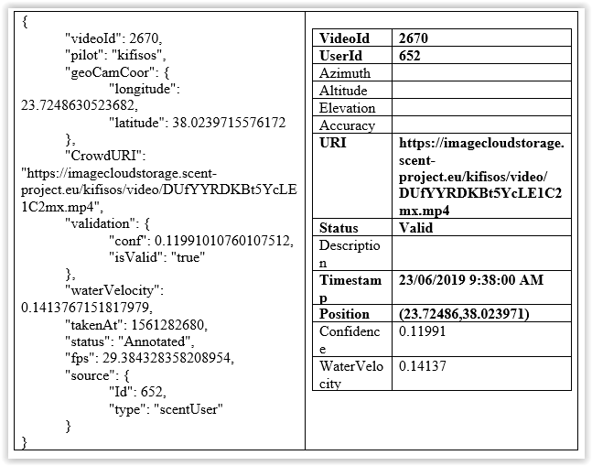
Scent Harmonisation Platform – Translators
Each translator receives data from a specific source, translates them to standardised resources and pushes the data to the Data Quality control;
The Data translators also ensure that the received data respect the format and types of the data models.;
They are using the available information in the received data object, trying to transform it based on the requirements of each standard.
Notes:
Scent project aims to establish an inter-connected citizen centric observation web and thus an IoT enabled paradigm is being adopted.
Key Challenges with the standards used in similar projects and applications such as OGC SOS are that are more applicable to in-situ sensors that have a fixed location. (In addition, the sensor location is part of the sensor description and subsequently a new sensor should be created for each new location). Thus, based on our analysis a novel implementation of the SensorThings API took place, providing the necessary flexibility for the citizen science data collected in the context of Scent Campaigns (i.e. Location independent of sensor, user independent of sensor).

Slide 5
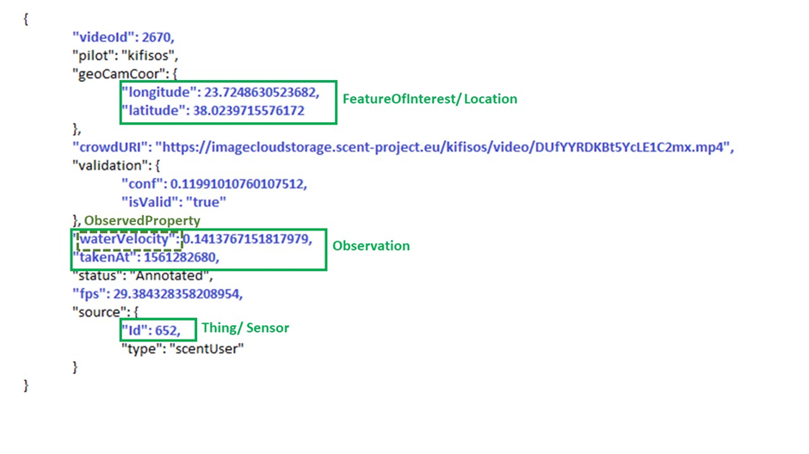
Scent Harmonisation Platform – Translators
The pre-defined the ObservedProperties based on the information collected in the project include:
Water level
Water velocity
Air Temperature
Soil moisture
LC/LU
For each data object received, one Observation entity and one FeatureOfInterest entity are created. In order for these entities to be valid, in the context of the standard, the Observation entity has to be associated with a Datastream. A Datastream is a unique combination of a Thing, Sensor and ObservedProperty entities.
Notes:
Scent project aims to establish an inter-connected citizen centric observation web and thus an IoT enabled paradigm is being adopted.
Key Challenges with the standards used in similar projects and applications such as OGC SOS are that are more applicable to in-situ sensors that have a fixed location. (In addition, the sensor location is part of the sensor description and subsequently a new sensor should be created for each new location). Thus, based on our analysis a novel implementation of the SensorThings API took place, providing the necessary flexibility for the citizen science data collected in the context of Scent Campaigns (i.e. Location independent of sensor, user independent of sensor).

Slide 6
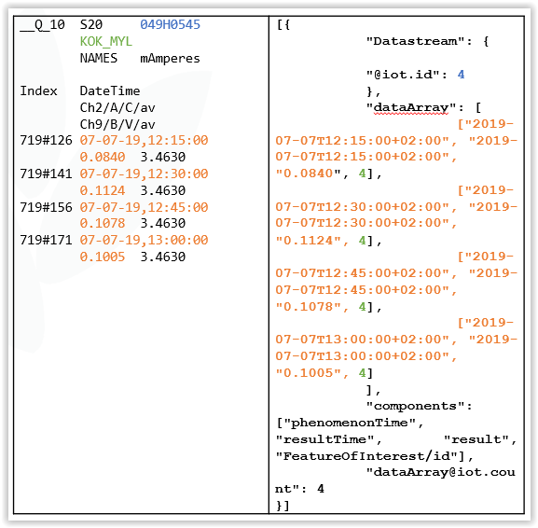
Scent Harmonisation Platform – Translators
Five in-situ monitoring stations have been installed in Kifisos measuring water level
Data loggers have been configured to send the measurements in csv-like files
Executable JAR file transforms the csv-like into JSON and pass the measurements in the Harmonisation platform BE endpoint

Slide 7
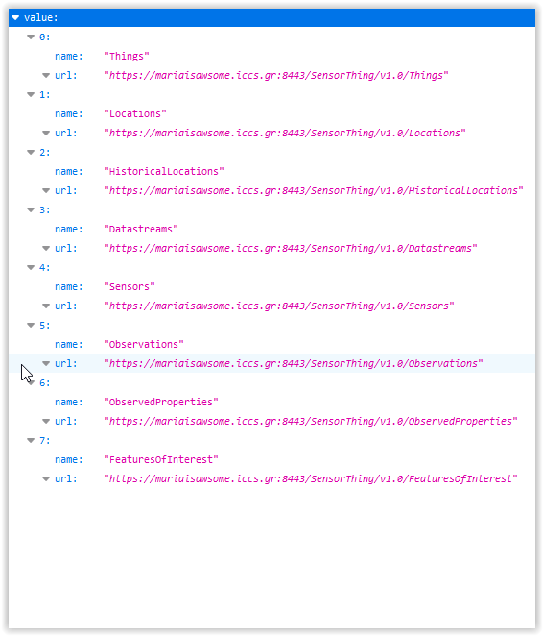
Scent Harmonisation Platform – Data provision
SensorThings API
The root URI of the service is https://mariaisawsome.iccs.gr:8443/SensorThing/v1.0/Things
It provides as a response a JSON object with a property named value.
The value of this property is a JSON Array containing one element for each entity set of the SensorThings Service.
Each element is a JSON object with at least two name/value pairs, one with name containing the name of the entity set (e.g., Things, Locations, Datastreams, Observations, ObservedProperties and Sensors) and one with name url containing the URL of the entity set.

Slide 8
Scent Harmonisation Platform – Get Requests
Category | URI pattern | Result
Collection of entities | SERVICE_ROOT_URI/ ENTITY_SET_NAME | A list of all entities in the specified entity set when there is no service-driven pagination imposed. The response is represented as a JSON object containing a name/value pair named value, a JSON array where each element is representation of an entity or of an entity reference.
Entity in a collection | SERVICE_ROOT_URI/ ENTITY_SET_NAME (ID_OF_THE_ENTITY) | A JSON object of the entity that holds the specified id in the entity set.
Property of an entity | SERVICE_ROOT_URI/ RESOURCE_PATH_TO_AN_ENTITY/ PROPERTY_NAME | The specified property of an entity that holds the id in the entity set.
Value of an entity’s property | SERVICE_ROOT_URI/ ENTITY_SET_NAME (ID_OF_THE_ENTITY)/ PROPERTY_NAME/$value | The raw value of the specified property of an entity that holds the id in the entity set.
A navigation property | SERVICE_ROOT_URI/ ENTITY_SET_NAME (ID_OF_THE_ENTITY)/LINK_NAME | A JSON object of one entity or a JSON array of many entities that holds a certain relationship with the specified entity.
An association link | SERVICE_ROOT_URI/ ENTITY_SET_NAME (KEY_OF_THE_ENTITY)/ LINK_NAME/$ref | A JSON object with a value property, a JSON array containing one element for each associationLink. Each element is a JSON object with a pair, with name url and the value of selfLinks of the related entities.

Slide 9
Scent Harmonisation Platform – Get Requests
$filter: allows clients to filter a collection of entities that are addressed by a request URL. The SensorThings API supports a set of functions that can be used in this query operation. We present in Appendix A3 the tables with all the filter operators and the functions required by the standard and supported by our implementation.
$count: specifies that the total count of items within a collection matching the request is returned along with the result. The default value is false.
$orderby: specifies the order in which items are returned from the service. The value of the $orderby system query option may contain a comma-separated list of expressions whose primitive result values are used to sort the items.
$skip: specifies the number for the items of the queried collection that are excluded from the result. The value of $skip system query option is a non-negative integer n.
$top: the limit on the number of items returned from a collection of entities. The value of the $top system query option is a non-negative integer n.
$expand: indicates the related entities to be represented inline. The value of the $expand query option is a comma separated list of navigation property names.
$select: the service returns only the properties explicitly requested by the client. The value of a $select query option is a comma-separated list of selection clauses. Each selection clause SHALL be a property name or a navigation property.

Slide 10
Scent Harmonisation Platform – API Calls
Functionality
Access the service root URI
API call
https://mariaisawsome.iccs.gr:8443/SensorThing/v1.0/ It returns a JSON array containing one element of each entity set of the SensorThings Service
Functionality
Select an observed property (i.e. water velocity) and get all the Datastreams given the selected observed phenomenon Then take all the observations under a Datastream
API call
https://mariaisawsome.iccs.gr:8443/SensorThing/v1.0/ObservedProperties(4)/ https://mariaisawsome.iccs.gr:8443/SensorThing/v1.0/ObservedProperties(4)/Datastreams https://mariaisawsome.iccs.gr:8443/SensorThing/v1.0/ObservedProperties(4)/Datastreams(402)/Observations?$filter=phenomenonTime%20ge%202018-11-15T00:00:00.000Z%20and%20phenomenonTime%20le%202018-11-17T00:00:00.000Z&$count=true

Slide 11
Scent Harmonisation Platform – API Calls
Functionality
Select all the observations for an observed phenomenon for a citizen science campaign
API call
https://mariaisawsome.iccs.gr:8443/SensorThing/v1.0/ObservedProperties(4)/Datastreams?$expand=Observations($expand=FeatureOfInterest)$filter=phenomenonTime%20ge%202018-11-15T00:00:00.000Z%20and%20phenomenonTime%20le%202018-11-17T00:00:00.000Z&$count=true&$count=true
Functionality
Get all available Things (or else Data Providers) Get all historical locations (both time and coordinates) for the Thing (Data Provider in the case of SCENT) that has been chosen in the previous step
API call
https://mariaisawsome.iccs.gr:8443/SensorThing/v1.0/Things https://mariaisawsome.iccs.gr:8443/SensorThing/v1.0/Things(268)/HistoricalLocations?$expand=Locations

Slide 12
Scent Harmonisation Platform – API Calls
Functionality
Get all Datastreams for the Thing that has been chosen previously. Sensor and Observed Property entities info are also being fetched in order to populate the second dropdown list
API call
https://mariaisawsome.iccs.gr:8443/SensorThing/v1.0/Things(268)/Datastreams?$expand=Sensor,ObservedProperty
Functionality
Get all observations along with their coordinates (through the FeatureOfInteret entity) that are associated with the given Datastream
API call
https://mariaisawsome.iccs.gr:8443/SensorThing/v1.0/Datastreams(438)/Observations?$expand=FeatureOfInterest
Functionality
Get the collection of Things, the Datastreams associated with each Thing, and the ObservedProperty associated with each Datastream.
API call
https://mariaisawsome.iccs.gr:8443/SensorThing/v1.0/Things?$expand=Datastreams/ObservedProperty

Slide 13
Scent Harmonisation Platform – API Calls
Functionality
Get all the values from an in-situ sensor that exceed a certain value
API call
https://mariaisawsome.iccs.gr:8443/SensorThing/v1.0/Datastreams(3)/Observations?$filter=phenomenonTime%20ge%202018-11-15T00:00:00.000Z%20and%20phenomenonTime%20le%202018-11-17T00:00:00.000Z%20and%20result%20gt%200.36&$count=true
Functionality
Get all the values from both the in-situ and citizen scientists that exceed a certain value during campaign
API call
https://mariaisawsome.iccs.gr:8443/SensorThing/v1.0/ObservedProperties(1)/Datastreams?$expand=Observations($filter=phenomenonTime%20ge%202018-11-15T00:00:00.000Z%20and%20phenomenonTime%20le%202018-11-17T00:00:00.000Z%20and%20result%20gt%200.36)&$top=5&$count=true

Slide 14
THANK YOU FOR YOUR ATTENTION Any questions?
Valantis Tsiakos
valantis.tsiakos@iccs.gr
I-SENSE Group, ICCS
This project has received funding from the European Union’s Horizon 2020 research and innovation programme under grant agreement no 688930.

