Slide 1

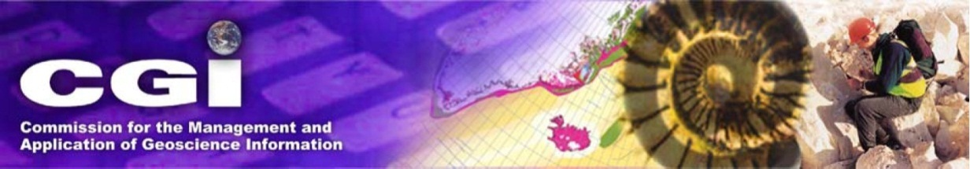

GeoSciML 4
The OGC/CGI Geoscience Data Transfer Standard
Ollie Raymond
CGI/OGC GeoSciML Standards Working Group
EU Joint Research Centre, Italy

Slide 2
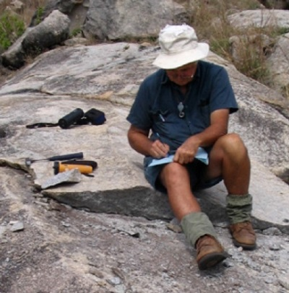

Why A Data Standard?
AzGS
Canada
USA
Australia
GSV
W W W
UK
GSQ
Mapping applications, web portals, modelling applications, analytical tools
France
INTEROPERABILITY
“My stuff works with your stuff”
Russia
GeoSciML - The History and Future of an International Geoscience Data Transfer Standard, JRC Ispra, October 2015
GeoSciML - The History and Future of an International Geoscience Data Transfer Standard, St Petersburg, June 2013

Slide 3

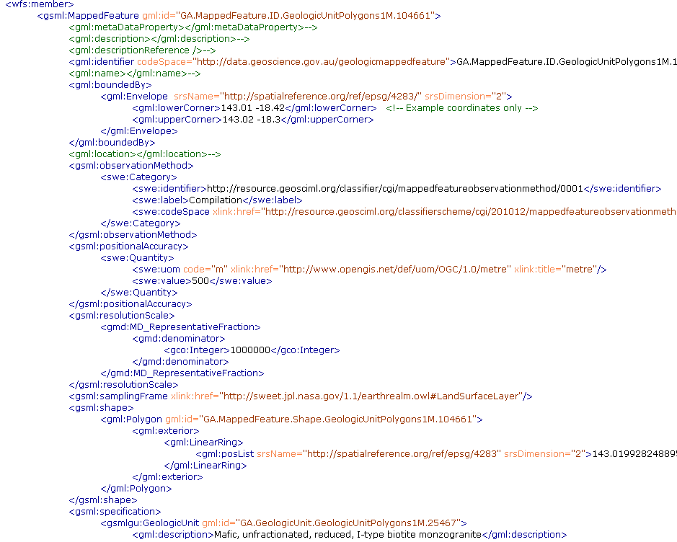
What is GeoSciML?
GeoSciML is a GML-based data standard for
exchange of geoscientific information
UML data model
XML markup language
GeoSciML - The History and Future of an International Geoscience Data Transfer Standard, JRC Ispra, October 2015

Slide 4
How Does GeoSciML Work?
Canada
GSC
?
USA
USGS
UK
BGS
W W W
VSEGEI
Russia
Australia
GA
Myriad of source databases
(eg, Oracle, ArcGIS, PostGIS, MySQL)
GeoSciML - The History and Future of an International Geoscience Data Transfer Standard, JRC Ispra, October 2015

Slide 5
How Does GeoSciML Work?
GSC
GSC mapping
to GeoSciML
WMS
WFS
Canada
USA
USGS
USGS mapping
to GeoSciML
WMS
WFS
UK
BGS
BGS mapping
to GeoSciML
WMS
WFS
W W W
GeoSciML
VSEGEI
VSEGEI mapping
to GeoSciML
WMS
WFS
Russia
Australia
GA
GA mapping
to GeoSciML
WMS
WFS
Myriad of source databases
(eg, Oracle, ArcGIS, PostGIS, MySQL)
Web services applications
(eg, Geoserver, XtraServer, ArcGIS)
OGC web services using GeoSciML standard data structure
GeoSciML - The History and Future of an International Geoscience Data Transfer Standard, JRC Ispra, October 2015

Slide 6
How Does GeoSciML Work?
GSC
GSC mapping
WMS
WFS
Canada
USA
USGS
USGS mapping
WMS
WFS
UK
BGS
BGS mapping
WMS
WFS
W W W
GeoSciML
VSEGEI
VSEGEI mapping
WMS
WFS
Russia
Australia
GA
GA mapping
WMS
WFS
Many data formats
One standard format
GeoSciML - The History and Future of an International Geoscience Data Transfer Standard, JRC Ispra, October 2015
GeoSciML - The History and Future of an International Geoscience Data Transfer Standard, St Petersburg, June 2013

Slide 7











A Brief History
  British Geological Survey, UK
  CSIRO, Australia
  Geological Survey of Canada
  US Geological Survey
  Arizona Geological Survey, USA
  Geological Survey of Japan
  Geoscience Australia
  Geological Survey of Victoria, Australia
  BRGM, France
  Geological Survey of Sweden
  Geological Survey of Italy (ISPRA)
  Geological Survey of Finland
  GNS Science, New Zealand
  Landcare Research, New Zealand
  BGR, Germany
  plus many observers
Contributing
Organisations
GeoSciML - The History and Future of an International Geoscience Data Transfer Standard, JRC Ispra, October 2015

Slide 8
A Brief History
In the beginning… 2003, Edinburgh
  first meeting held to begin harmonisation of geological data models developed in North America, Europe, and Australia
  seed of the IUGS Commission for Geoscience Information (CGI)
  several precursor data models were considered, including
    the North American Data Model (NADM)
    the Australian Exploration and Mining Markup Language (XMML)
    the Multi-Lingual Thesaurus of Geology
    and others…
  2004, Ottawa & Florence
    CGI was launched and the Interoperability Working Group (IWG) formed
      IWG would be the vehicle for GeoSciML development for the next 8 years
GeoSciML - The History and Future of an International Geoscience Data Transfer Standard, JRC Ispra, October 2015

Slide 9
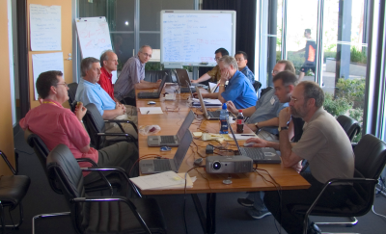
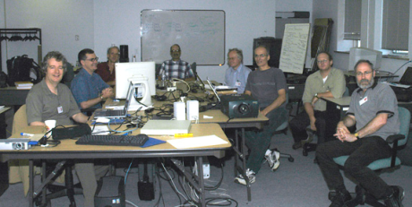
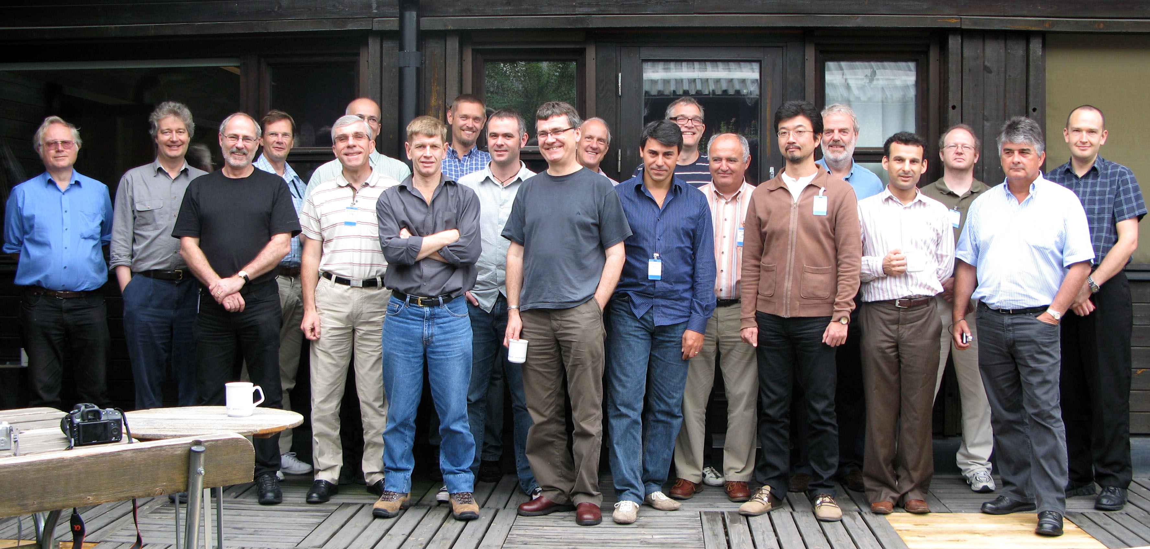
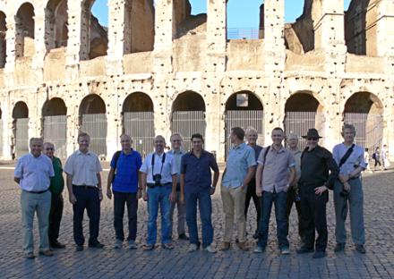
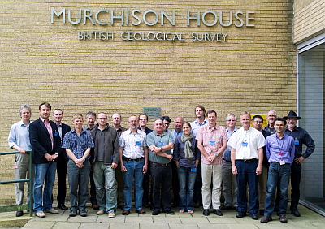
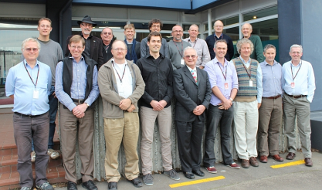
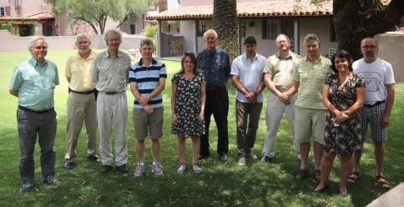
A Brief History
2004
2004, Perth
  first official meeting of the IWG GeoSciML
  Task Group
2005, Ottawa
  GeoSciML version 1
2006, Orleans, Liege & Brussels
2007, Tucson & Melbourne
  GeoSciML version 2
2008, Orleans, Uppsala & Oslo
2009, Quebec
2010, Rome
2011, Edinburgh
2012, Wellington
  GeoSciML version 3
2013, Redlands & St Petersburg
2014, Tucson
2014
GeoSciML - The History and Future of an International Geoscience Data Transfer Standard, St Petersburg, June 2013

Slide 10
The Move to OGC
January 2013, Redlands, OGC TC meeting
  Memorandum of Understanding signed between CGI and OGC
  first meeting of the GeoSciML Standards Working Group under OGC
  bound by OGC documentation specifications
  the imprimatur of an established multi-domain spatial standards organisation
GeoSciML - The History and Future of an International Geoscience Data Transfer Standard, St Petersburg, June 2013

Slide 11
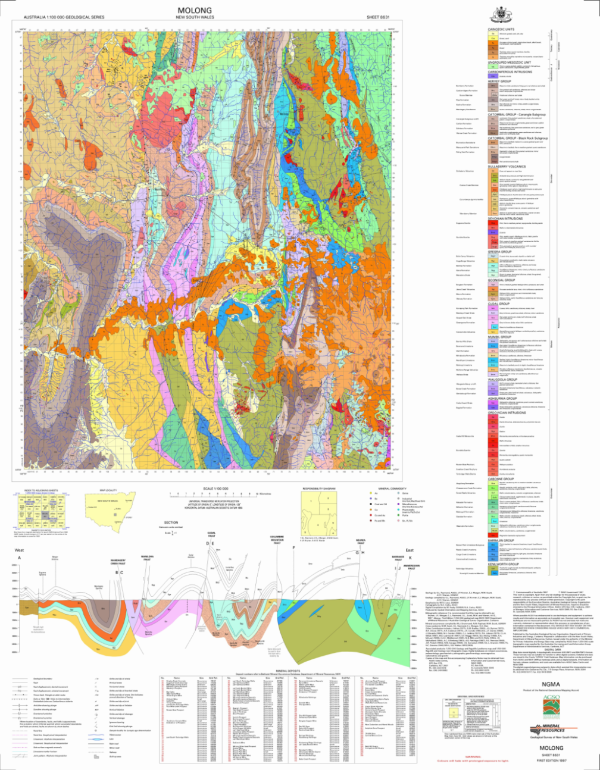
GeoSciML - the early days
Original use case for GeoSciML version 1
  describe and exchange features found on a typical geological map
    geological units
      including hierarchy, relationships
    geological structures
      contacts, faults, folds
    geological age
    earth materials
GeoSciML - The History and Future of an International Geoscience Data Transfer Standard, St Petersburg, June 2013

Slide 12
GeoSciML evolution
Version 2
  updates to the v1 data model for:
    geological units
    geological events/age
    earth materials
    physical properties
  added:
    boreholes
    fossils
Version 3
  repackaged the model
  into 13 separate schema modules
  updates to the data model for:
    geological units
    feature relations
    events/age
    physical properties
    boreholes
  added:
    geomorphological units
    alteration
    geological sampling
    laboratory analysis metadata
GeoSciML - The History and Future of an International Geoscience Data Transfer Standard, JRC Ispra, October 2015

Slide 13
GeoSciML evolution
GeoSciML v3 changes, continued -
used and extended new OGC and ISO standards, including:
  Geography Markup Language (GML v3.2)
  Observations and Measurements (O&M v2.0)
  Sensor Web Enablement (SWE Common v2.0)
GeoSciML v2 elements were retired in v3 in favour of using existing OGC and ISO standards
  eg, used SWE Common to deliver numeric and controlled terminology attributes
  geoscience vocabularies are managed outside of the GeoSciML data model
  vocabulary terms encoded using a “byReference/xlink” pattern to enable links to vocabulary services
GeoSciML - The History and Future of an International Geoscience Data Transfer Standard, St Petersburg, June 2013

Slide 14
GeoSciML v3 problems
User feedback indicated that the GeoSciML v3 model was too complicated to implement for the majority of users who had only relatively simple data
  delivery of even simple geological data required understanding half a dozen different schemas and delivery of a lot of unnecessary empty XML elements
  the complex conceptual data model was theoretically correct, but was not implemented in a sufficiently user-friendly way to attract users
GeoSciML - The History and Future of an International Geoscience Data Transfer Standard, JRC Ispra, October 2015
GeoSciML - The History and Future of an International Geoscience Data Transfer Standard, St Petersburg, June 2013

Slide 15
GeoSciML v3.2
Internal model dependencies
GeoSciML - The History and Future of an International Geoscience Data Transfer Standard, St Petersburg, June 2013

Slide 16



The Solution
Strategy #1 - GeoSciML-Portrayal
  a simplified data standard that can deliver a small subset of GeoSciML using simple features WFS or WMS on a map with a minimum of data requirements or controlled terminology
  Version 2.0.1 was published in July 2013
    geological units, contacts, faults, borehole collars
  retained a little controlled terminology to enable standard query and symbolisation of map features (eg, using SLD)
  currently implemented by several major map data sharing initiatives, including:
    OneGeology
    USGIN
    AuScope
GeoSciML - The History and Future of an International Geoscience Data Transfer Standard, JRC Ispra, October 2015
GeoSciML - The History and Future of an International Geoscience Data Transfer Standard, St Petersburg, June 2013

Slide 17
GeoSciML Portrayal
Strategy #1 continued - GeoSciML-Portrayal
  the new version of GeoSciML-Portrayal has simple feature map schemas for:
    geological units
    geomorphological units
    faults and shears
    contacts
    boreholes
    geological specimens
    site observations
  an introductory, easy to implement, entry point for users of GeoSciML
    designed to be compatible with the widest possible range of client and server software applications
GeoSciML - The History and Future of an International Geoscience Data Transfer Standard, JRC Ispra, October 2015
GeoSciML - The History and Future of an International Geoscience Data Transfer Standard, St Petersburg, June 2013

Slide 18
The Solution
Strategy #2 - GeoSciML v4
  re-organise GeoSciML v3 to enable users to deliver all the core features of GeoSciML using one (or very few) XML application schemas
  core schema would satisfy the majority of use cases asked by geologists of digital data
    satisfy requirements of key major users of complex features like INSPIRE
    eg;
      “show me the geological units which contain shale”
      “show me the geological units of Permian age”
      “show me where the thrust faults are”
  more complicated and less commonly used features, attributes and relationships are delivered by using extension schemas
GeoSciML - The History and Future of an International Geoscience Data Transfer Standard, JRC Ispra, October 2015

Slide 19
The Solution
Strategy #2 continued - GeoSciML v4
  remove mandatory nature of most properties
    removes the need for data providers to deliver many unpopulated XML elements
    enables “profiling” of the GeoSciML standard for different purposes
  use Schematron to control different community profiles of GeoSciML
    INSPIRE and other regional communities; soil and other geological sub-disciplines
    XSD schema validation on its own cannot ensure interoperability
    Schematron can used to validate not only data structure, but also data content
      eg; test the use of agreed vocabularies
    makes GeoSciML potentially more attractive to more user communities
GeoSciML - The History and Future of an International Geoscience Data Transfer Standard, JRC Ispra, October 2015

Slide 20
GeoSciML v3.2 schemas
From this...
GeoSciML - The History and Future of an International Geoscience Data Transfer Standard, St Petersburg, June 2013

Slide 21
To this...
GeoSciML v4.0 schemas
GeoSciML
Basic
Geological Timescale
Geological Sampling & Analysis
GeoSciML
Extension
Borehole
GeoSciML
Portrayal
GeoSciML - The History and Future of an International Geoscience Data Transfer Standard, St Petersburg, June 2013

Slide 22
GeoSciML Basic
GeoSciML - The History and Future of an International Geoscience Data Transfer Standard, St Petersburg, June 2013

Slide 23
GeoSciML Basic
GeologicFeature
Parent class for all geological features. Describe relations between any type of geological feature
GeoSciML - The History and Future of an International Geoscience Data Transfer Standard, St Petersburg, June 2013

Slide 24
GeoSciML Basic
MappedFeature
Spatial (ie, mapped) representation of a geological feature
shape (GML), scale
scope of the map
positional accuracy, type of exposure
GeoSciML - The History and Future of an International Geoscience Data Transfer Standard, St Petersburg, June 2013

Slide 25
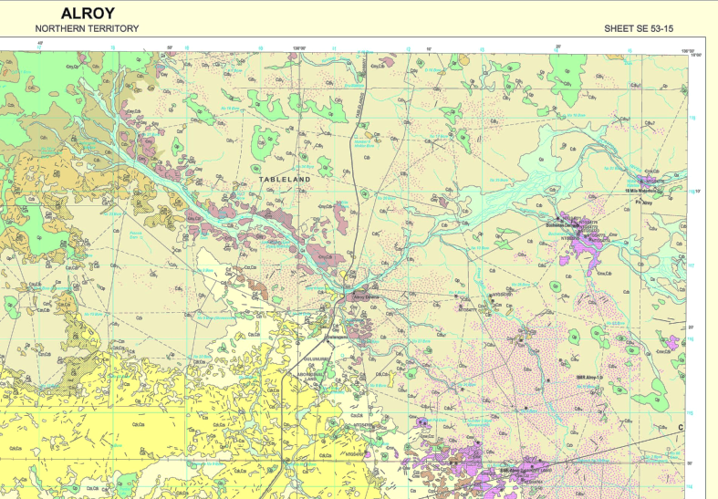
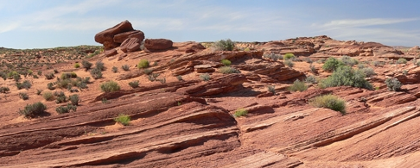
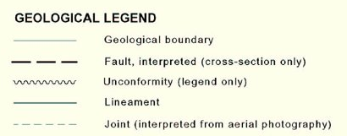
MappedFeature
MappedFeature
Spatial (ie, mapped) representation of a geological feature
shape (GML), scale
scope of the map
positional accuracy, type of exposure
GeoSciML - The History and Future of an International Geoscience Data Transfer Standard, St Petersburg, June 2013

Slide 26
GeoSciML Basic
Geological Units
      Basic description of stratigraphic, lithological, and other rock unit types
name
rank
stratigraphic hierarchy
GeoSciML - The History and Future of an International Geoscience Data Transfer Standard, St Petersburg, June 2013

Slide 27
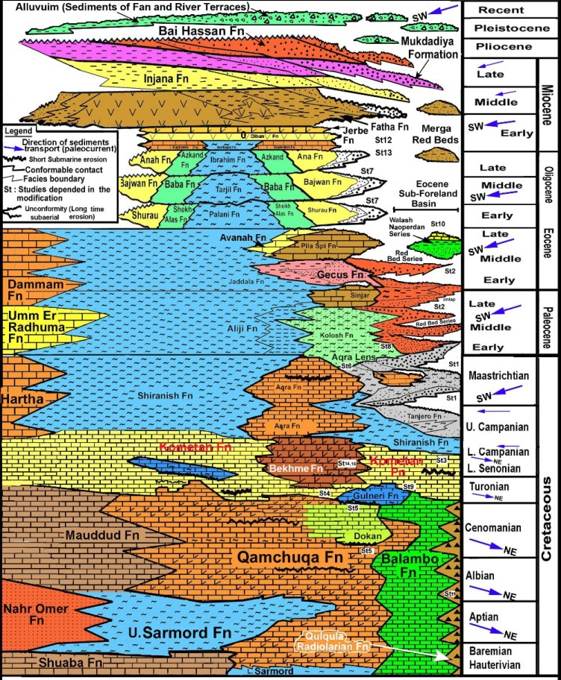
GeoSciML Basic
Geological Units
      Basic description of stratigraphic, lithological, and other rock unit types
name
rank
stratigraphic hierarchy
GeoSciML - The History and Future of an International Geoscience Data Transfer Standard, St Petersburg, June 2013

Slide 28
GeoSciML Basic
Lithology
Basic description of earth materials which comprise a geological unit
GeoSciML - The History and Future of an International Geoscience Data Transfer Standard, St Petersburg, June 2013

Slide 29
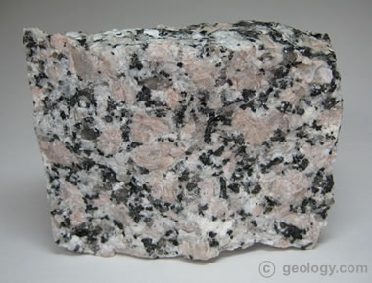
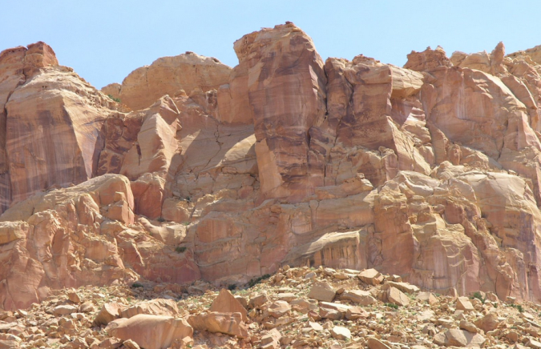
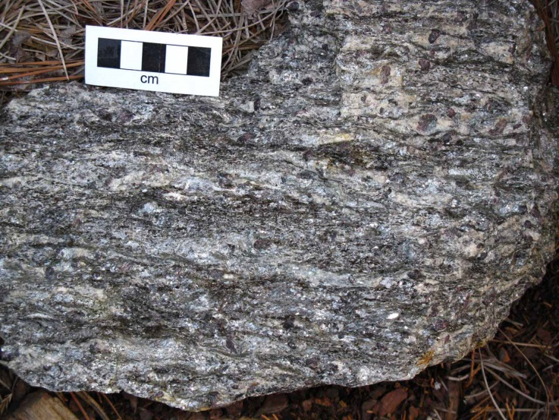
GeoSciML Basic
Lithology
Basic description of earth materials which comprise a geological unit
GeoSciML - The History and Future of an International Geoscience Data Transfer Standard, St Petersburg, June 2013

Slide 30
GeoSciML Basic
Geological
Structures
  Basic description of the most common types of geological structures
    contacts
    faults and shears
    folds
    foliation
GeoSciML - The History and Future of an International Geoscience Data Transfer Standard, St Petersburg, June 2013

Slide 31
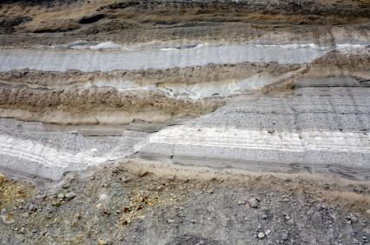
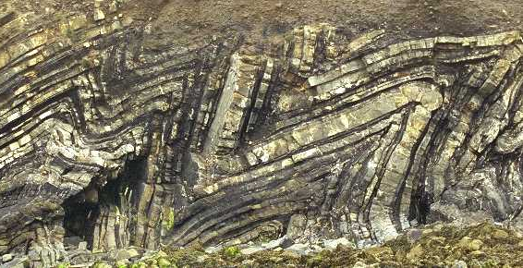
Geological Structures
Geological
Structures
  Basic description of the most common types of geological structures
    contacts
    faults and shears
    folds
    foliation
GeoSciML - The History and Future of an International Geoscience Data Transfer Standard, St Petersburg, June 2013

Slide 32
Geological Events
Geological Events
Basic description of
numeric age
named age
environment and process
GeoSciML - The History and Future of an International Geoscience Data Transfer Standard, St Petersburg, June 2013

Slide 33
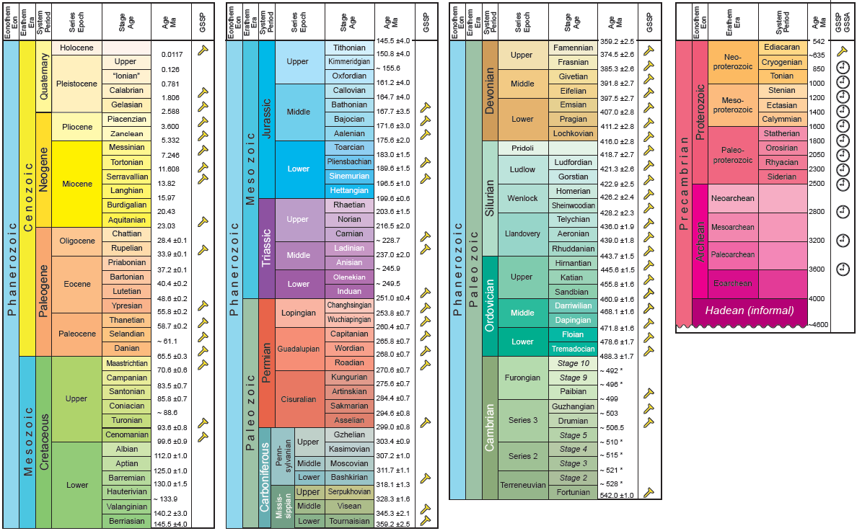
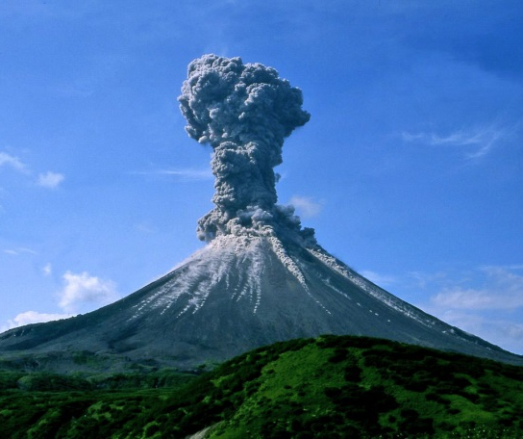
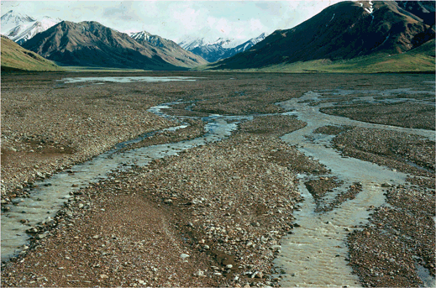
Geological Events
Geological Events
Basic description of
numeric age
named age
environment and process
GeoSciML - The History and Future of an International Geoscience Data Transfer Standard, St Petersburg, June 2013

Slide 34
Geomorphology
Geomorphology
Basic description of natural and
anthropogenic geomorphological
features
regolith landforms
glacial features
landslides and geohazards
GeoSciML - The History and Future of an International Geoscience Data Transfer Standard, St Petersburg, June 2013

Slide 35
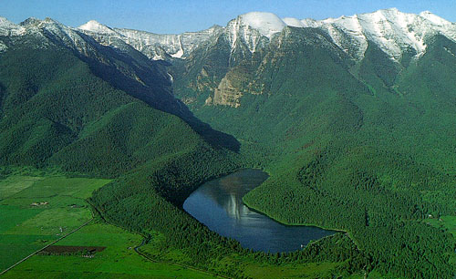
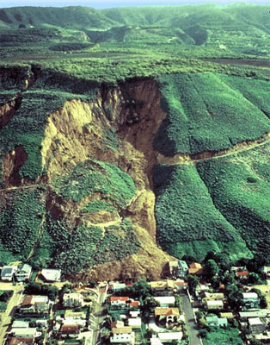
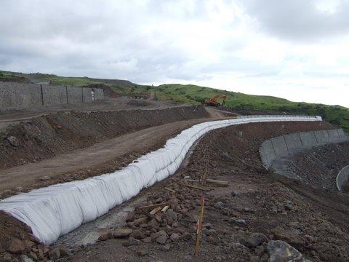
Geomorphology
Geomorphology
Basic description of natural and
anthropogenic geomorphological
features
regolith landforms
glacial features
landslides and geohazards
GeoSciML - The History and Future of an International Geoscience Data Transfer Standard, St Petersburg, June 2013

Slide 36
eg; GeologicUnit and EarthMaterials extension
GeoSciML Extension Pattern
GeoSciML Basic
GeoSciML Extension
GeoSciML - The History and Future of an International Geoscience Data Transfer Standard, St Petersburg, June 2013

Slide 37
GeologicStructure extension
GeoSciML Extension Pattern
GeoSciML Basic
GeoSciML Extension
GeoSciML - The History and Future of an International Geoscience Data Transfer Standard, St Petersburg, June 2013

Slide 38
Geological Extensions of O&M
Borehole
ISO19156 O&M
GeoSciML
in GeoSciML v4, downhole intervals are no longer restricted to just GeoSciML MappedFeatures
  other domain communities can use their own downhole features with GeoSciML Borehole
GeoSciML - The History and Future of an International Geoscience Data Transfer Standard, St Petersburg, June 2013

Slide 39
Geological Extensions of O&M
Geological Sampling and Analysis
ISO19156 O&M
GeoSciML
GeoSciML - The History and Future of an International Geoscience Data Transfer Standard, St Petersburg, June 2013

Slide 40
Internet Resources
GeoSciML home
http://www.geosciml.org
http://schemas.geosciml.org
http://resource.geosciml.org
Public Mailing list
https://lists.opengeospatial.org/mailman/listinfo/geosciml
Public GeoSciML SWG wiki
http://external.opengeospatial.org/twiki_public/GeoSciMLswg/WebHome
GeoSciML Standards Working Group (OGC members only)
https://portal.opengeospatial.org/?m=projects&a=view&project_id=420
Wiki for GeoSciML work pre-OGC
https://www.seegrid.csiro.au/wiki/CGIModel/
GeoSciML - The History and Future of an International Geoscience Data Transfer Standard, JRC Ispra, October 2015

Slide 41

Thank you
Any Questions?
Ollie Raymond
GeoSciML Standards Working Group
Open Geospatial Consortium
IUGS Commission for the Management and Application of Geoscience Information
Web: www.cgi-iugs.org
Email: oliver.raymond@ga.gov.au
Phone: +61 2 6249 9575

