Slide 1
Updates on boreholes in EPOS: architecture, BoreholeView
104th OGC Technical Committee – GeoScience DWG session
Southampton, United Kingdom
Sylvain Grellet - BRGM
GeoSciML DWG - 12 September 2017

Slide 2
Starting Point
Improve Borehole data
Discoverability
Interoperability

Slide 3
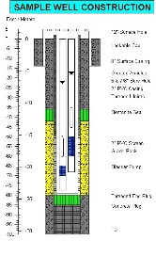
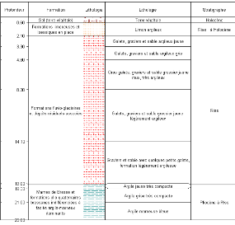
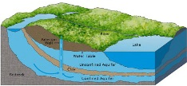
Borehole in EPOS – Resource View
Env. Monitoring Facility
URI
URI
Construction
details
Observations
URI
Borehole
URI
URI
URI
URI
URI
Observations / logs
Geology / HydroGeology
URI

Slide 4
Using BoreholeView as an EU Index and shortcut to national data flows
detailedDescription -> (URI)
BoreholeIView
groundWaterLevel, groundWaterChemistry, … -> (URI)
gsmlp:identifier-> (URI)
Env. Monitoring Facility
URI
…
URI
Construction
details
Observations
URI
Borehole
URI
URI
URI
URI
gsmlp:geophysicalLogs
gsmlp:geologicalDescription -> (URI)
URI
Observations / logs
Geology / HydroGeology
URI

Slide 5
EPOS BoreholeView – feeding the index
Each institution maintains its Borehole BoreholeView (SF-0) service and underlying complexFeature flows
Only SF-0 flows are harvested at EU level, to support discovery
BoreholeIView
Geoportals
(EPOS, INSPIRE, ...)
Pub/Sub
…

Slide 6
Work done
EPOS Borehole View
Extension of GeoSciML BoreholeView -> ChangeRequest to GeoSciML SWG
Ex instance
4 data providers included, others in progress
Conceptual model to support national flows
See Henning presentation (‘Updates on boreholes in EPOS: BoreholeUML model’)

Slide 7
Work done
Feedback on the approach
Exposing summary Information (SF-0) is easier/faster than complex Feature -> more data providers
Harvesting simpleFeature is more reasonable than complex Feature
WFS on complexFeature is not meant/suited to synchronize millions of instances !
Harvesting a ‘Borehole vCard’ just for discovery makes more sense
BRGM test implementation using GWML2:GW_GeologyLog, INSPIRE:EnvironmentalMonitoringFacility, WaterML2
=> linked data approach validated !

Slide 8
Interaction expected with GeoScience DWG
Discuss the Borehole conceptual model UML done
Trigger a BoreholeIE to consolidate this within the OGC
conceptual, then logical
clarify the triangle in OGC
Borehole
GeoSciML
GroundWaterML

Slide 9
Extra content after this slide

Slide 10
EPOS BoreholeView

Slide 11
EPOS BoreholeView – use
BoreholeView
gsmlp:identifier-> (URI)
Borehole
gml:identifier SHALL contain a unique identifier for this BoreholeView representation
gsmlp:identifier SHOULD resolve to an internationnaly agreed complexFeature representation of a Borehole (e.g : Inspire Geology, GeoSciML,…)
…

Slide 12
EPOS BoreholeView – use
BoreholeView
groundWaterLevel -> (URI)
Env. Monitoring Facility
URI
Observations
Borehole
…
URI
URI
…
…
…
URI
Geology / HydroGeology
Tested Implementation
Environmental Monitoring Facility provided according to INSPIRE EF theme
groundWaterLevel provided either using OGC:WaterML2.0 and/or INSPIRE:PointTimeSeries
HydroGeology feature provided according to GWML2 and/or INSPIRE:Geology:HydroGeology
…

Slide 13
EPOS BoreholeView – use
BoreholeIView
Borehole
…
gsmlp:geologicalDescription
-> (URI)
URI
URI
Observations / logs
Tested Implementation
geologicalDescription (log) provided using GWML2:GW_GeologyLogCoverage
…

Slide 14
EPOS BoreholeView – Conclusions
Data provider
So far: BRGM, GEUS, ISPRA, UU-SE
Coming: BGS, GSI, GFZ, CGS, GeoZS
Add more EU geological surveys and research partners
IT
EU Borehole Index entries now around 3 Million (this will grow)
Need for faster WFS : Studying connexion of GeoServer app-schema with Sol’R index
Having the index indexed by search engines
Exposing its content in (Geo)JSON-LD
Where is the reference ontology we could point to

Slide 15
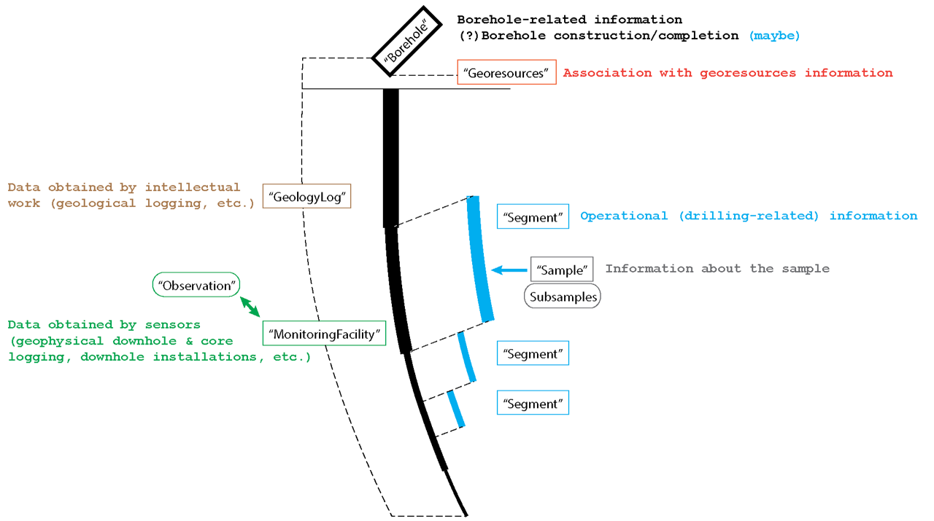
EPOS Borehole conceptual model

Slide 16
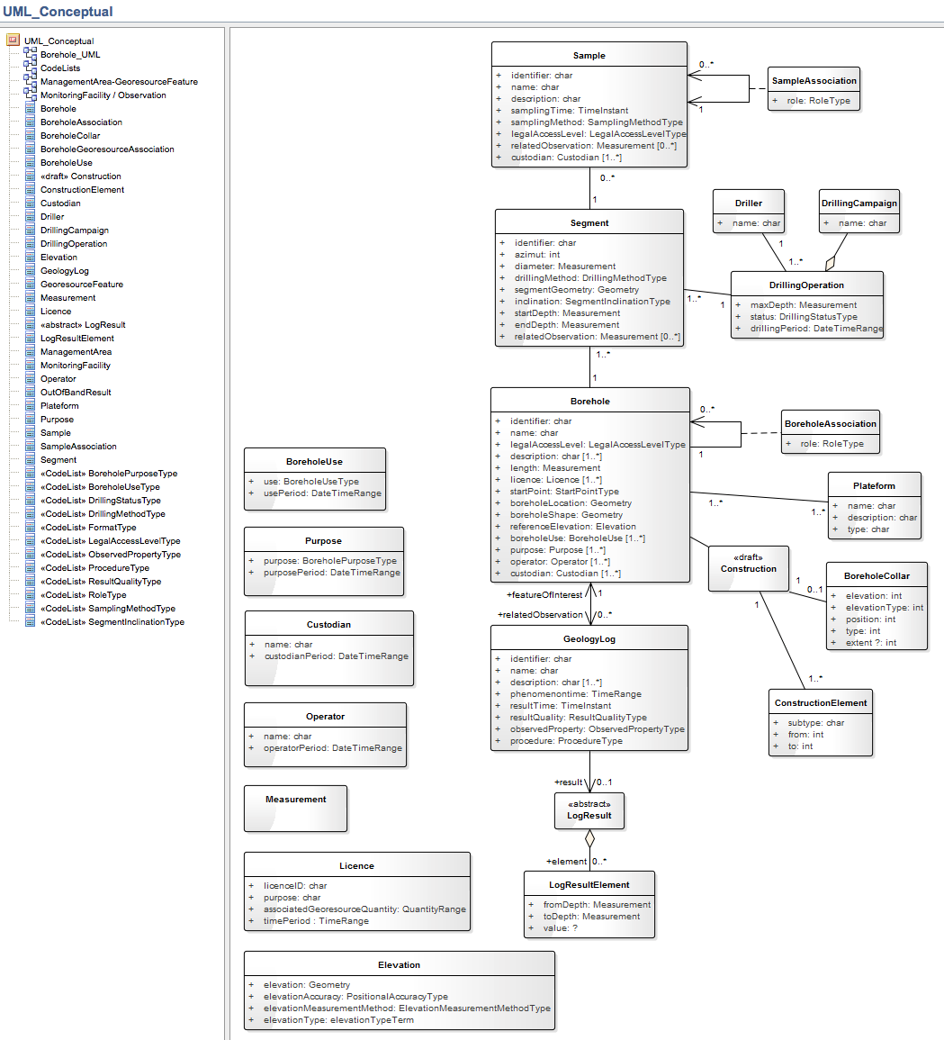
EPOS Borehole conceptual model

Slide 17
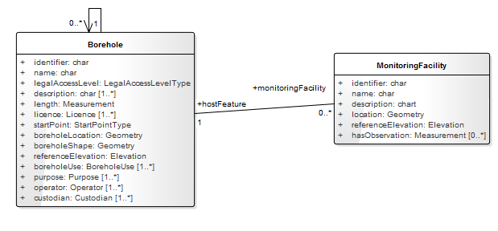
EPOS Borehole conceptual model

Slide 18
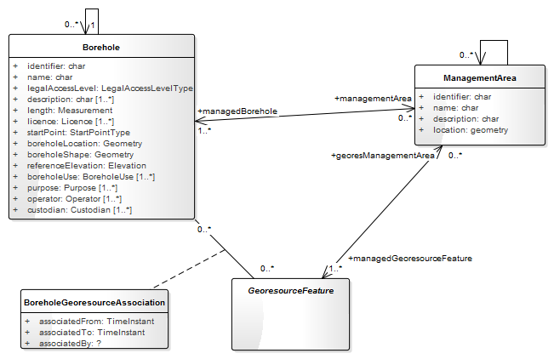
EPOS Borehole conceptual model

Slide 19
EPOS Borehole conceptual model – next steps
Finish first version of conceptual UML model
90% done. Only GWML2 mapping missing
Share it with OGC SWGs (GeoSciML, GWML) for feedback
Decide on logical model for implementation, then services and code lists
Logical models
Within OGC : GeoSciML4.1 / GWML2 overlap on this.
Maybe some clarification is needed
Implement

Slide 20
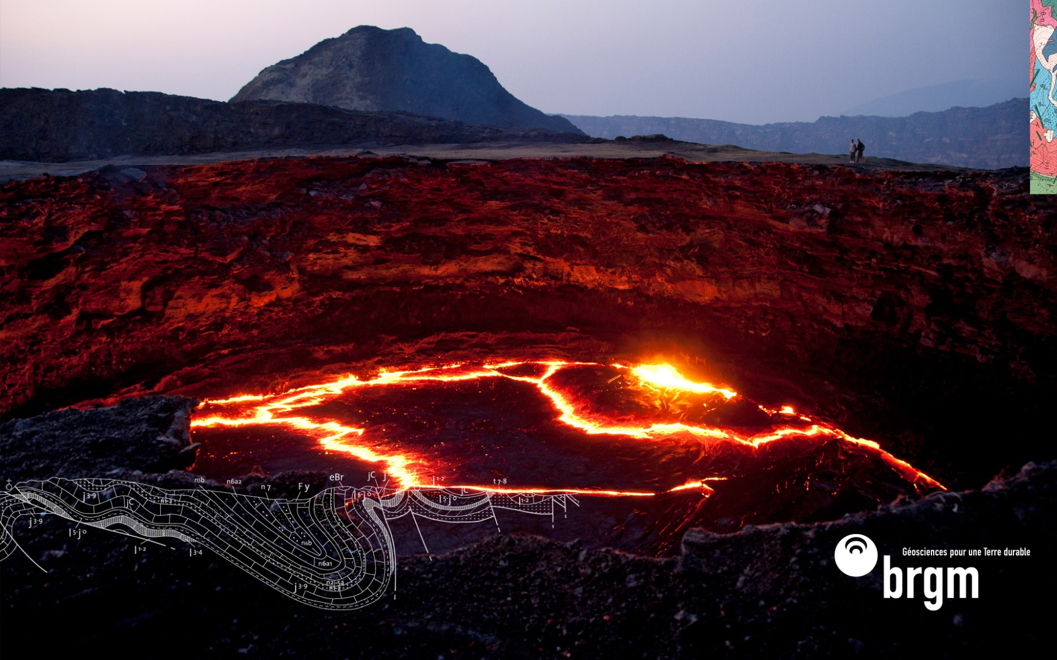
Thanks
s.grellet@brgm.fr

