Slide 1

OGC Health DWG
February 10th, 2014

Slide 2

OGC Health DWG – February 10th, 2014
AGENDA
Quick Backgrounder
Identify key areas of mutual interest / prioritize
Discuss goals / activities in 2014
Identify interested parties (OGC members and non-members) and other key linkages
Co-Authors for Feature Articles
Co-Chair nominations
Next Webinar/Meeting is March 27th, during OGC TC

Slide 3
Health DWG Charter
An OGC Health Domain Working Group enables the identification and prioritization of use cases, business and technical requirements that will provide the most significant value, or mitigate the most significant risks in the health arena.
Participants collaborate in:
User and Technical requirements gathering
Informing the development of standards
Facilitating exchange of knowledge, best practices
Demonstration through interoperability projects
Implementation of interoperable technical solutions
Notes:
Through bringing together geospatial vendors and end-users, an OGC Health Domain Working Group will cultivate technical solutions which support interoperable concepts, data definitions, formats and services for publishing, search, and exchange of geospatial information. Through efforts to identify requirements, gaps in standards and opportunities for demonstration, a Health Domain Working Group will contribute to development of open mapping standards in support of public health requirements.

Slide 4
Health DWG Role / Functions
Convene OGC members and non-members across the health domain
Build Capacity for technical solutions, knowledge exchange, requirements gathering and prioritization
Assimilate Inputs toward geospatial standards development, including data definitions, formats, and services for publishing, discovery, exchange, and queryability of geospatial information
Help to focus on sub-sets of health where geospatial data and interoperability are required
Spawn Demonstration Projects, Interoperability Experiments, and Interoperability Pilots
Educate and Inform Health communities-of-practice
Notes:
Capture participant inputs:

Slide 5
Examples of OGC standards in support of health applications
Prior / existing initiatives using OGC Standards
EU INSPIRE (health and safety working group)
GEOSS AIP, EO2Heaven project: EO2HEAVEN (Earth Observation and Environmental Modelling for the Mitigation of Health Risks) is a research project co-funded by the European Commission as part of the 7th Framework Programme (FP7) Environmental theme. It started on 1st February 2010. EO2HEAVEN contributes to a better understanding of the complex relationships between environmental changes and their impact on human health.
Neurosiences, University of San Diego
Prior GeoConnections funded projects
Other OGC DWGs (cross-pollination)

Slide 6
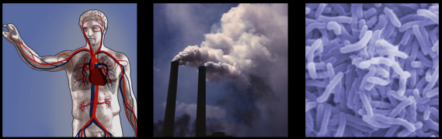

Health Case Studies for GEOSS
Environmental effects on allergies and cardiovascular diseases in Dresden and the Free State of Saxony, Germany
Environmental challenges to health in South Durban, South Africa, due due to human exposure on atmospheric pollution
Investigating the impact of environmental and climatic variables on the cholera outbreaks in Uganda

Slide 7
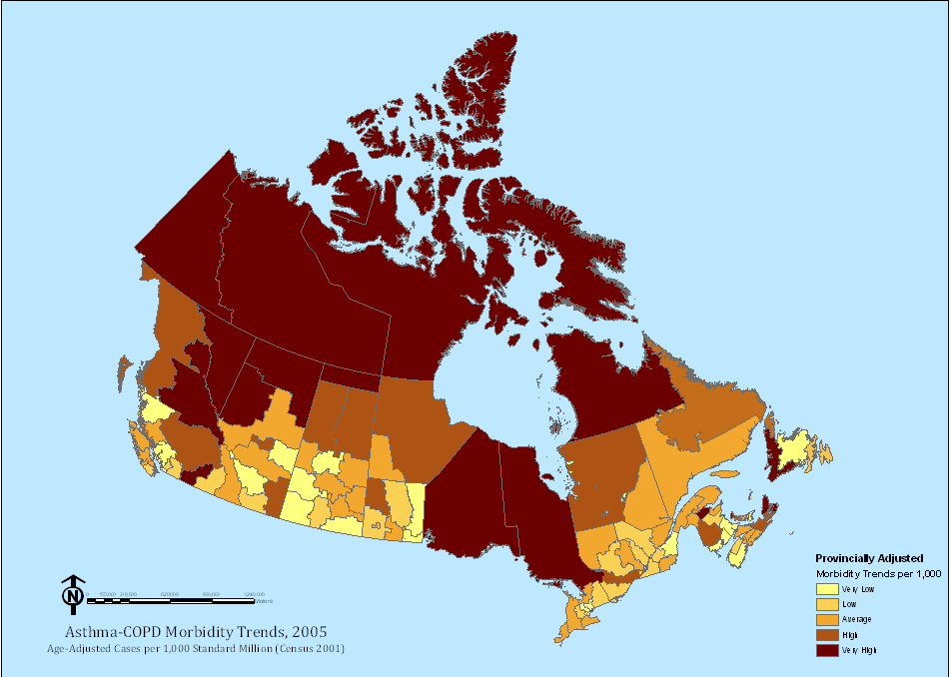
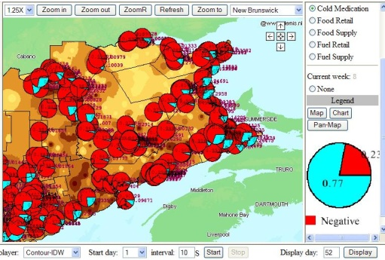
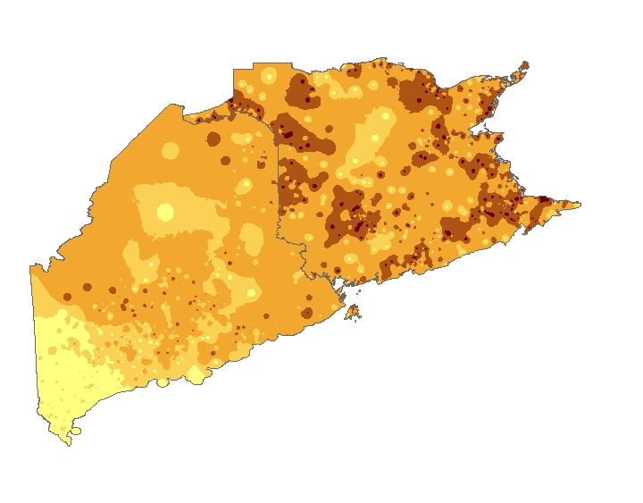
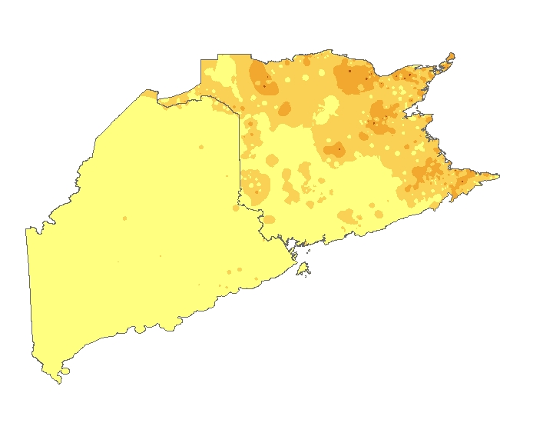
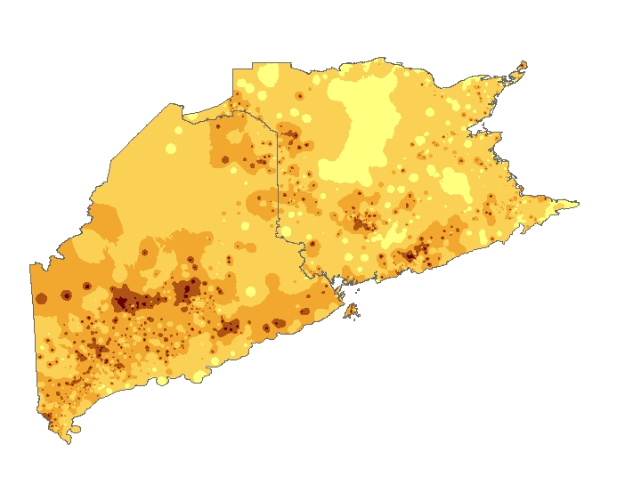
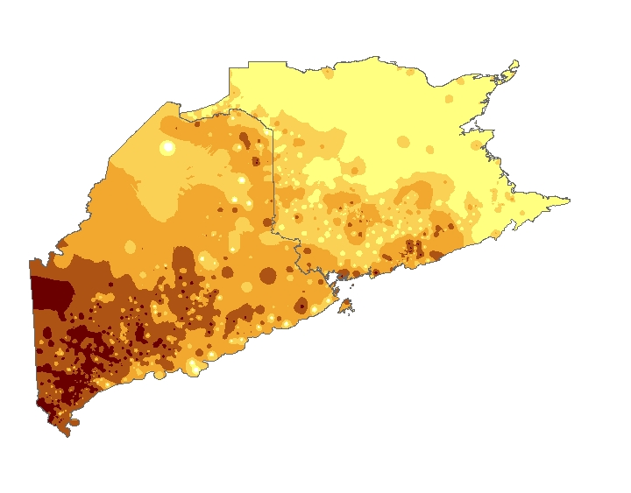
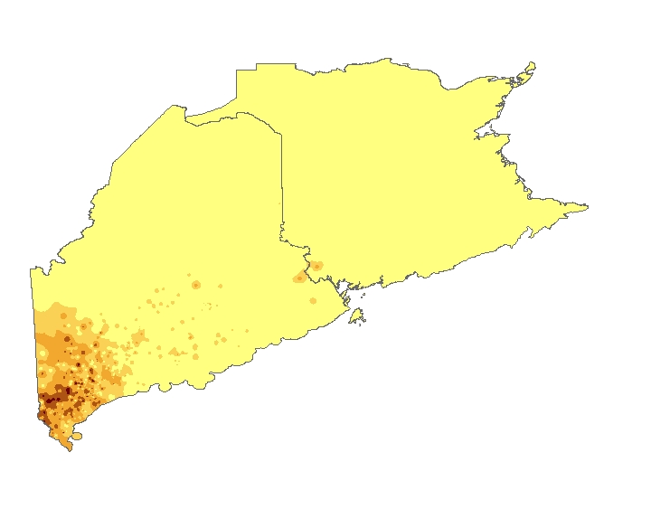
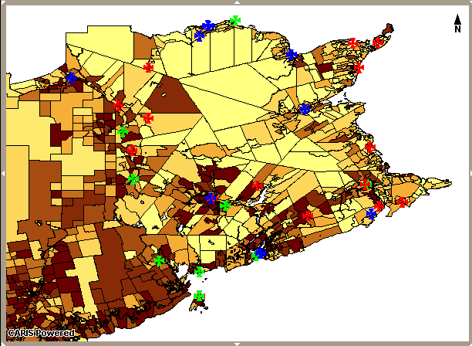
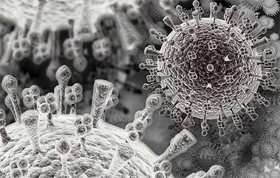
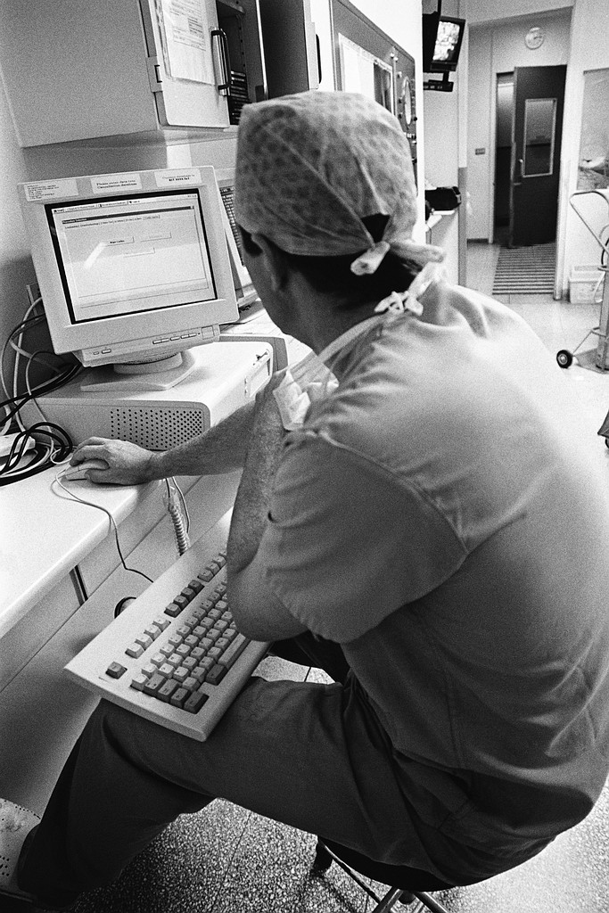
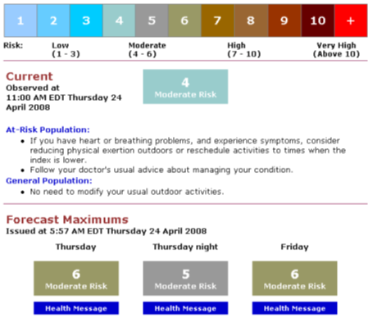


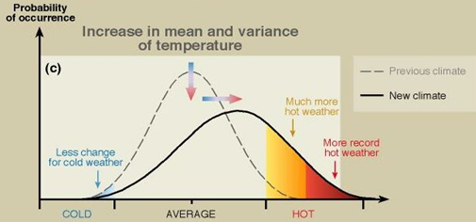
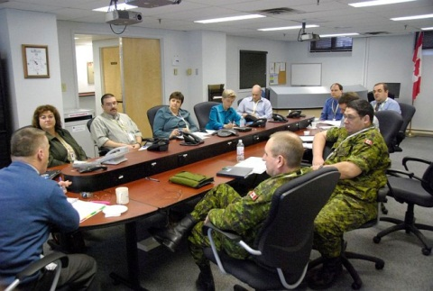
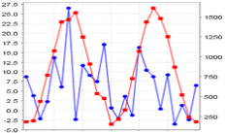
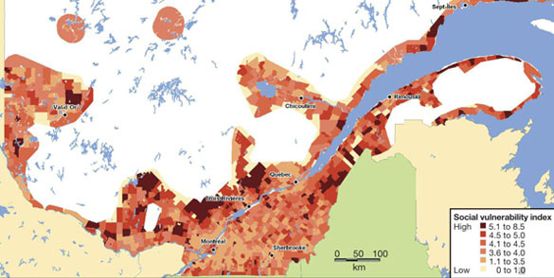
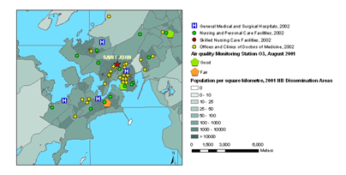
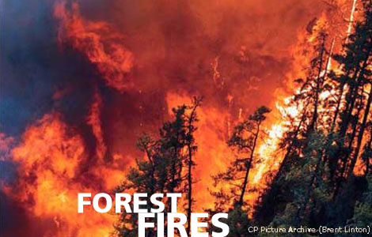
Statements of Need
Time series pandemic surveillance with time-tag in WMS
Monitor trends in chronic illness and infectious disease – with WPS, WFS, WMS
Model Climate Change and Health Impacts for Risk Assessment
Prevention, Alerting, Response, Recovery
Public education, resource planning (including vaccination campaigns) with WMS
Assess Vulnerable Populations / Zones
Notes:
Background: Several implementations of WMS, WFS, WPS, and Health XML Schema (2003-2012), in Canadian Geospatial Data Infrastructure; extensive research in the health domain, growing interest, but no centralized resource.
Purpose/Proposal: To extend interoperable encodings and demonstrate combining OWS (e.g. WPS workflow) in support of:
Monitoring trends in population health, chronic illness, and the spread of disease
Climate-health impact modeling / risk assessment and communication – this could include applications to help identify and protect vulnerable populations at global, regional, national, and sub-national scales
Disease prevention and alerting, emergency response, disaster recovery
Public Education (scale: from local to global) – e.g. health guidelines for air quality
Health care program and resource management, cost reduction – this could include applications at global, national, and subnational scales
Infectious disease surveillance and control (scale: below state level to int’l) e.g. Asthma programs
Cross-border exercises (e.g. import health-related OWS into HAZUS/MASAS for simulation exercises in US/Canada)
Other: Medical applications
Capture Participant Inputs:

Slide 8
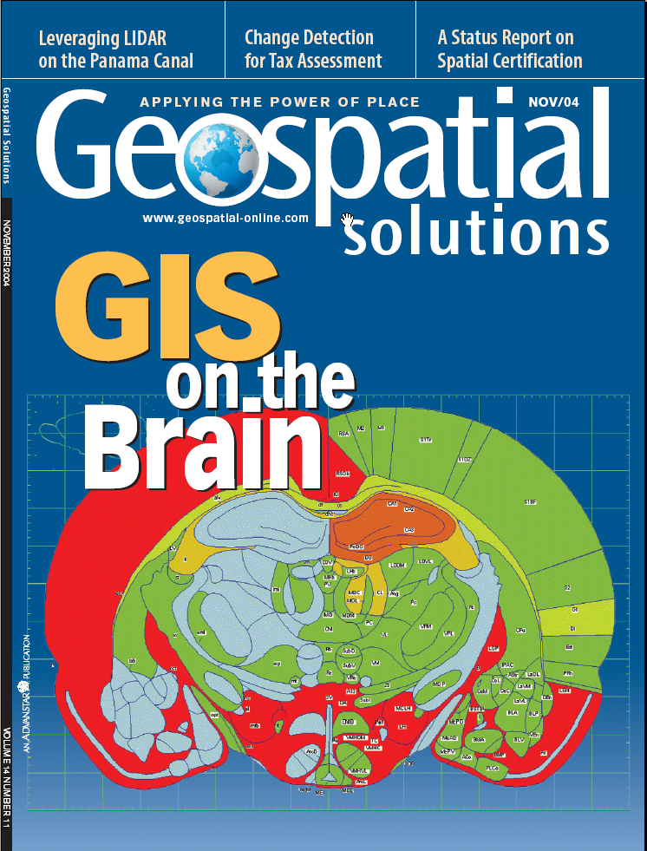
Integrating digital atlases of the brain: atlas services with WPS
Ilya Zaslavsky
San Diego Supercomputer Center, UCSD
Lead of the INCF
Digital Atlasing Infrastructure Task Force

Slide 9
OGC Health DWG – February 10th, 2014
AGENDA
Quick Backgrounder
Identify key areas of mutual interest / prioritize
Discuss goals / activities in 2014
Identify interested parties (OGC members and non-members) and other key linkages
Co-Authors for Feature Articles
Co-Chair nominations
Next Webinar/Meeting is March 27th, during OGC TC

Slide 10
Areas of Mutual Interest
Health info privacy
Schemas/profiles (health observation data)
Best practices for implementing existing standards
Environment – health
Data sets without spatial elements (service for spatial + non spatial data discovery)
Time series – WMS – relationship between health and environment; BP for optional spec
Health info at different scales, dissaggregation
HL7 / Health outcome
Charter Statements of Need do a good job

Slide 11
Goals / Activities in 2014
Convene – regular sessions Health DWG, monthly (as needed)
Interoperability requirements: Health Info Privacy, HL7, Spatial/Non Spatial Data
Populating the Wiki
Learn from OGC MetOceans DWG (time-series), OGC Hydrology DWG
Knowledge exchange via listserve – Stories on interoperability, how OGC standards work
Info for potential users

Slide 12
Feature Article(s)
Themes, Topics, Authors

Slide 13
General Discussion / Smorgusboard
Capture Participant Inputs:
Show value through map outcomes (health/enviro) for potential power and useage (combining geospatial data and GIS) – show health community
Health DWG Goals and Objectives
Key Drivers
Parallel and Collaborative Initiatives
Use Cases / Business Needs
Potential Champions / Key Users
Standards of Interest
Technical solutions
Market Analysis / Scope
Costs / benefits analysis =
value proposition
Notes:
Capture participant inputs:

Slide 14
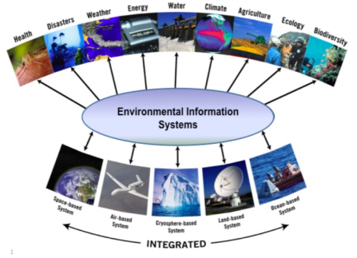
GEOSS AIP Architecture
Community Objectives
Enterprise
Viewpoint
GEOSS Vision and Targets
Societal Benefit Areas
System of Systems/ Interoperability
Information Framework
Abstract/Best Practices
Services
Earth Observations
Geographic Features
Spatial Referencing
Metadata and Quality
GEOSS Data-CORE
Information
Viewpoint
Computational
Viewpoint
Catalog/Registry
Access and Order
Processing Services
Sensor Web
User Identity
Optimized Design/Development
Use Cases
Component Types
Engineering
Viewpoint
Technology
Viewpoint
Tutorials
RM-ODP Viewpoints

Slide 15
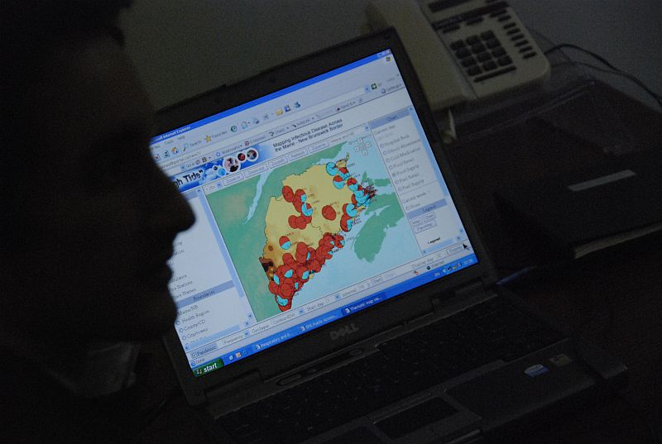



Eddie Oldfield
Tel: 506-453-0887
Email: eoldfield@bellaliant.net
Member, Resilient Communities Working Group,
National Platform for Disaster Risk Reduction
Member, OGC - www.opengeospatial.org
Member, QUEST - www.questcanada.org
Spatial Quest Solutions: Business /HST Number: 83696 5905 RT0001
Spatial Quest Solutions
Fredericton, NB
www.spatialquest.com
Business /HST Number: 83696 5905 RT0001
Website: http://spatialquest.com
Notes:
Closing Thoughts. For further information, please do not hesitate to contact me.

