Slide 1

MED-MI Partnership
Professor Lora E Fleming MD PhD MPH MSC

Slide 2

MED-MI Partnership
MED MI
Medical and Environmental Data Mash-up Infrastructure

Slide 3
Investigators
LE Fleming, B Golding , A Kessel, A Haines, M Depledge, A Cichowska, S Hajat, C Sarran, N Osborne, C Sabel, T Bailey, C Whitmore, N Cocksedge, R Barciela, G Nichols, C Little, M Djennad, G Nichols, H Gordon Brown, N Kaye, M Cherrie, Y Clewlow

Slide 4








Institutional Partners & Funders

Slide 5
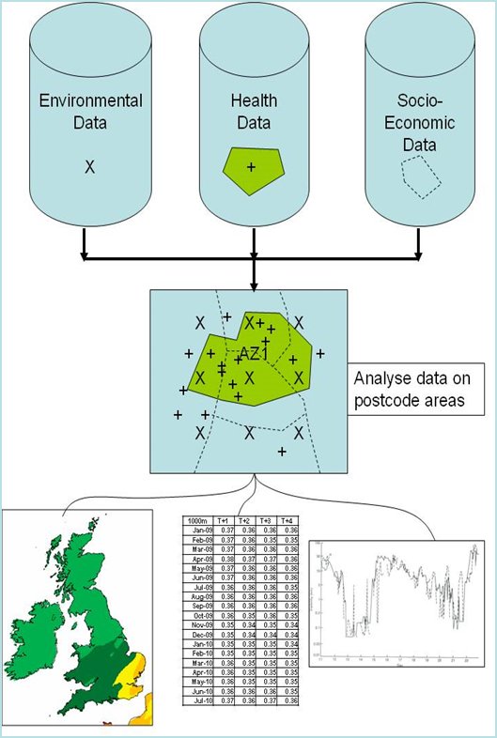
Aims
Create a central data and analysis source as an internet-based Platform which will be a vital new common resource for medical and public health research in the UK and beyond

Slide 6
Translational Applications
Facilitate novel research with environment and human health models;
Identify “hot spots” rapidly for targeted prevention, interventions, and research;
Provide healthcare practitioners and public health planners with relevant information for improving services for locations and populations identified at risk;
Initiate and evaluate interventions;
Disseminate and provide access to data as part of outreach and engagement with the research community, policymakers and civil society.

Slide 7
Objectives
Establish MED-MI Platform;
Perform the data “mash-up” by linking datasets;
Explore feasibility and vision of Platform with Demonstration Projects;
Establish initial website, and later, a portal for use;
Strengthen and explore collaborations with outside entities;
Disseminate the MED-MI Platform;
Develop and seek new collaborations and funding.

Slide 8
System Architecture
Data Layer
Processing Layer
Client Layer
FTP
Desktop Application
Archive data
Raw and Large
Processed data
Geoserver
Spatial data
OGC services
MEDMI Web Portal
MAP Viewer
Analysis Viewer
Forum
Metadata
Django Python Framework
Post GIS Database
Spatial / non-spatial data
Python Object
Processing tools
(SQL, R, IRIS, Scipy)
Python Object
WPS
SQL
SpatiaLite
Web Site
News
Bitbucket code repository
Notes:
8
Uploading of data:
Subsets of current data done through platform
Direct link to the database
Ftp to raw datastore (filezilla).

Slide 9
Databases: Environmental
Weather
  MIDAS (Fixed station observations)
  Daily Land Gridded 5km
  Monthly Land Gridded 5km
Pollen (station observations)
Solar Irradiance
Future
  Air Pollution (station observations)
  Daily Sea Surface Temperature Gridded 5km
  Marine biotoxins (station observations)
  ?Vector Surveillance
  ?NERC, ?CEH

Slide 10
Databases: Health
SGSS (Labbase)
?ONS Vital Statistics
?HeS
GP Clinical data
  ?TPP
  ?GPRD/CPRD, ?THIN, ?Eclipse
  ?SAIL (Wales)
Other Wish list
  Census, Biobank, 1958 Cohort, ALPAC
Other: Menieres

Slide 11
Demonstration Projects: Criteria
Availability of suitable data sets;
Impact of weather and the environment on human health and wellbeing;
Potential clinical and public health relevance, especially in vulnerable populations.

Slide 12
Demonstration Projects
Leverage NIHR HPRU
Extreme temperatures, air quality, and mortality
  - Hajat
Climate, weather, and infectious diseases
  Nichols/Djennad/Cichowska
Climate, oceanography, and harmful algal blooms (HABS) “blue sky” initiative
  Fleming/Barciela
- New Demonstration Projects?

Slide 13
Browser Application: storyboarding approach

Slide 14
Key Considerations for Browser Development
Accessibility
Flexibility
Open-source
Efficiency
User-friendliness
Cost-effectiveness
Sustainability

Slide 15
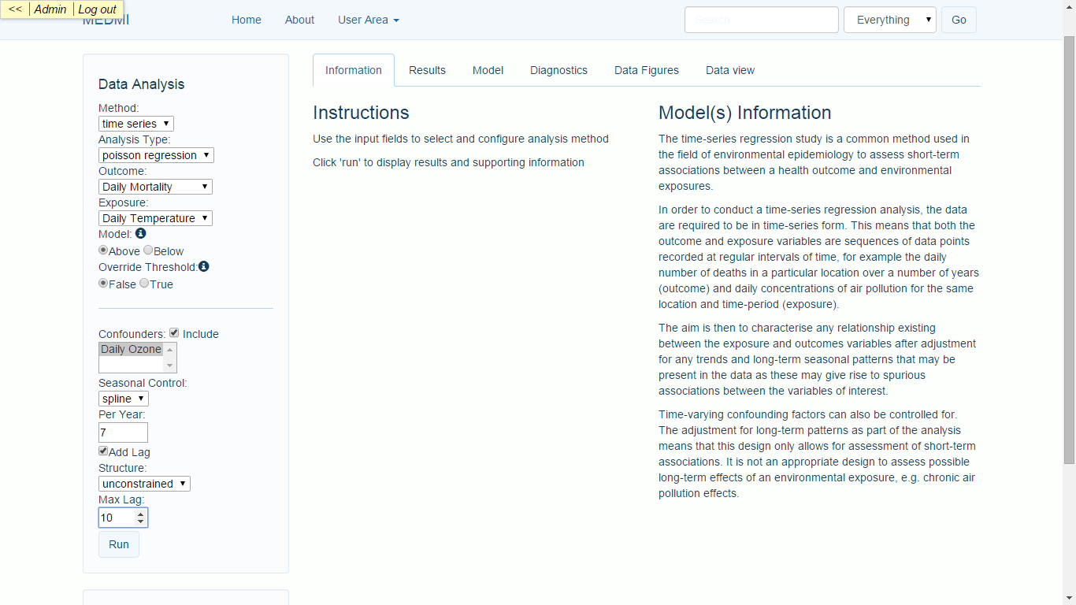
Web Browser: user-friendly inputs

Slide 16
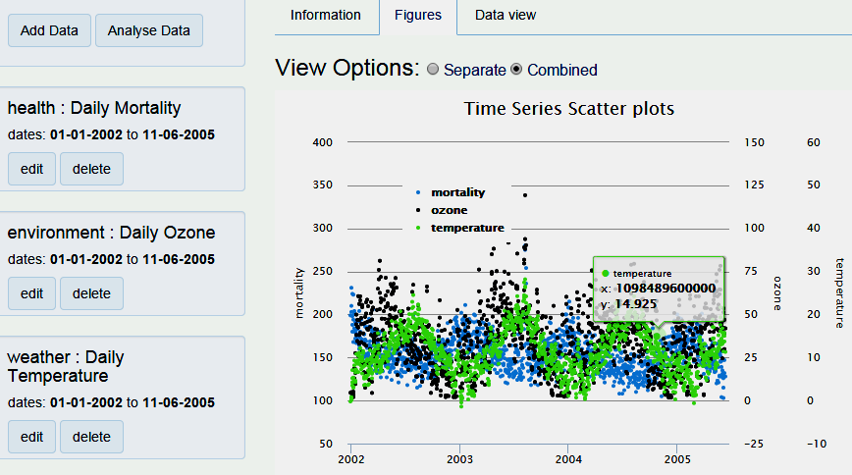
Web Browser: Data Discovery
View as combined figure

Slide 17
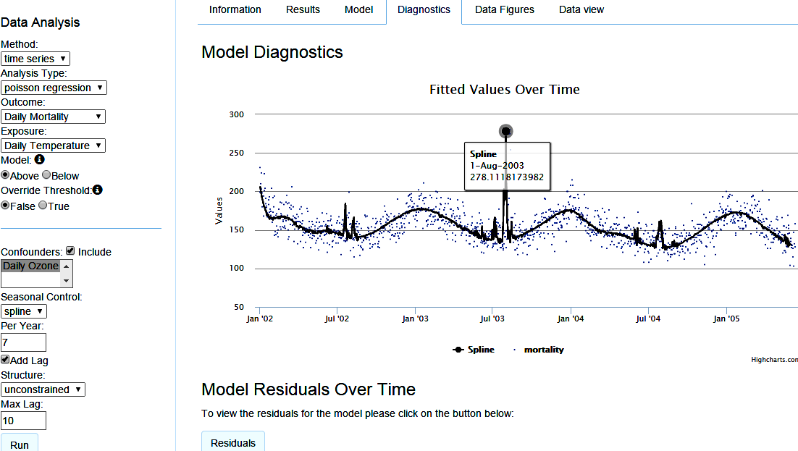
Web Browser: Data Analysis/Display
View Diagnostics of Model: Fitted Values

Slide 18
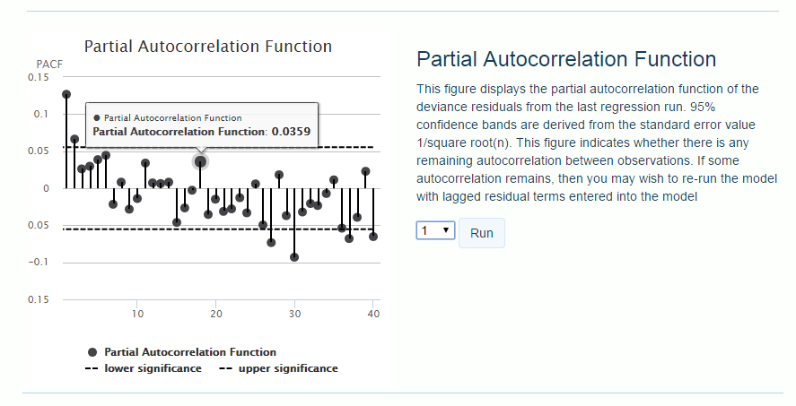
Web Browser: Data Analysis/Display

Slide 19
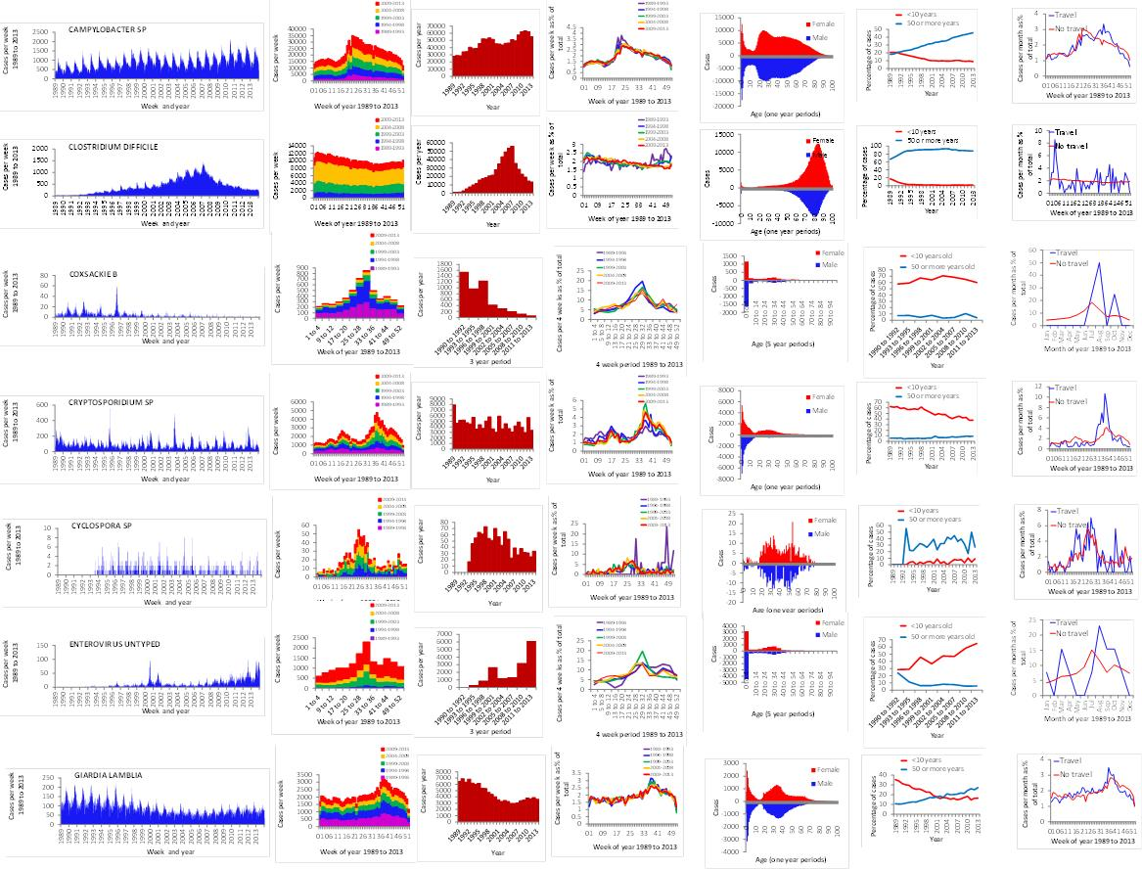
Web Browser: Data Visualisation

Slide 20
Example:
PHE SGSS (LABBASE) + Met Office Data
Over 14 million patient records
Over 2000 named species or serotypes
Looking for seasonality, long term trends, age distribution, etc.
  Temperature, Humidity, Rainfall, etc
Relating seasonality to weather
  the impact of climate change

Slide 21
Seasonality of Salmonellas
Non seasonal serotypes:
S. Adelaide
S. Albany
S. Arechavaleta
S. Arizonae
S. Colindale
S. Dublin
S. Durban
S. Ealing
S. Havana
S. Javiana
S. Marina
S. Mississippi
S. Monschaui
S. Montevideo
S. Nima
S. Oslo
S. Pomona
S. Poona
S. Rubislaw
S. Weltevreden
S. Worthington

Slide 22
Statistical and other Analysis Issues
Seasonality
Multiple drivers
Geographic/temporal data linkage
Autocorrelation
Random noise
Similar responses in different pathogens
Choice in method
Measuring the impact of between year changes
Trawling Surveillance dataset

Slide 23
Advisory Board
Professor Mike Depledge, Chair
Ms Harriet Gordon Brown, Administrator
Members: Prof Julia Slingo (Met Office), Prof Willie Hamilton (UoE), Prof Paolo Vineis (Imperial), Dr James Goodwin (Age UK), Prof Ed Conley (Cardiff), Dr Laura Burke (Irish EPA), Mr Adam Poole (Buro Happold), Ms Felicity Owen (Cornwall PH/Council), Mr Jeremy Nettle (IBM), Prof Kay-Tee Khaw (Cambridge), Prof Sujit Sahu (Southampton), Prof Virginia Murray (PHE), Prof Robert Gurney (Reading/NERC), Prof David Ford (Swansea), Mr Wayne Elliot (WMO), Mr Edward Hannan (HEPE), Ms Heather Boult (SW PIG)

Slide 24
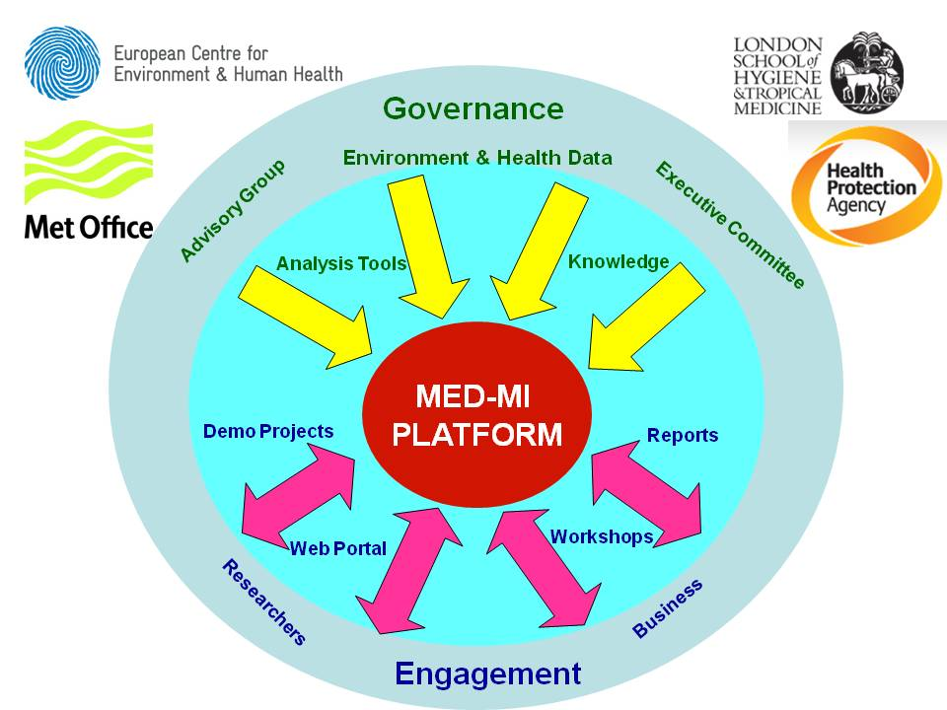

Slide 25
Progress to date
Presentations/Abstracts (13-- 3 continents)
  HPA, ISEE, AGU, APHA, MODISM, AMS, etc
Papers
  IJERPH
  Developing 3+
Grants
  NIHR HPRU; NERC Impact; NERC CASE PhD, Horizons 2020 BlueHealth
    [MRC Newton]
Other
  Big Data Workshop June 2014 Cornwall
  Open Geospatial Consortium Health Domain Sub group
  Current/New Investigator Meeting Jan 2015
  future Biobank Environment and Health Meeting Nov 2015
  ?Other

Slide 26
MED MI Pilot Projects 2015
Weather and Symptom Fluctuations in in Meniere’s Disease Dr Tyrrell, Dr Schmidt (ECEHH), Dr Sarran (Met Office)
Linkage Tools for Pre-Processing of Pollen data Dr McInnes, Dr Sarran (Met Office)
Osteoporosis & Solar Irradiance Dr Cherrie, Dr Osborne (ECEHH), Dr Sarran (Met Office)
Childhood Obesity and Neighbourhood Environments: Integrating SAIL and MEDMI Dr Rodgers, Mr Fry (SAIL, Swansea University), Dr Wheeler (ECEHH), Dr Sarran (Met Office)
Statistical Downscaling of Gridded Air quality data Professor Sahu (Southampton University)
Pathogen Seasonability regression trawling Professor Nichols (PHE), Dr Cherrie (ECEHH)

Slide 27
Logo, Website, URL, Servers
www.data-mashup.org.uk
The Demo 1 Modelling application is on the Web Server, for demonstration purposes (data used already public).
In the future:
The application will be to the Database/Application Server with more secure access and a more powerful machine. This Server will be used for researchers for the browser modelling application running against MEDMI held data.
The Web Server will run a standard Website displaying description, news, events, etc for the MEDMI project

Slide 28
MED MI Challenges
Short time period etc
Databases, especially human health
Staffing expertise
“Publishable” research
Long term funding
“Big Data” moving on……..
Communication
Expectations
Funding

Slide 29
Next Steps
Databases
Progress on Demonstration Projects
Server, Website, Platform
Governance, Ethics & Documentation
New Partners/Collaborators
Funding/Legacy Opportunities
  ?MRC Programme Grant
  ?Marie Curie COFUND, Horizon 2020; ?ERC Synergy
  ?Other

Slide 30

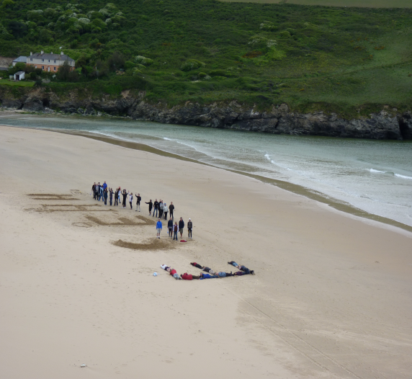

Questions?
Collaborations?
www.ecehh.org
Masters and PhD Programmes in Environment and Human Health
L.E.Fleming@exeter.ac.uk

