Slide 1
Status Update on AR Market and
Open & Interoperable
Augmented Reality
September 15, 2015

Slide 2
Agenda
Market changes
  Vendors/technology provider landscape
  Developers
  Users
  Enterprise (AR for Enterprise Alliance)
Open and Interoperable Augmented Reality
  March 2015 meeting outcomes
  Next meeting is October 2015 in Seoul

Slide 3




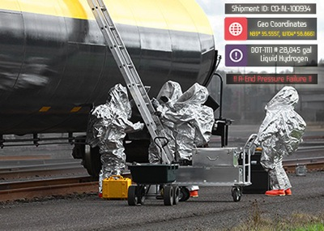






Augmented Reality in 2015
Physical World
AR Experience Authoring
AR Experience Delivery
Specific AR Use Cases
100,000+ developers with access, skills and expressed desire to author AR experiences
Nearly 1B people with at least one AR-ready device (sensors and output/display support)
Digital Assets

Slide 4



















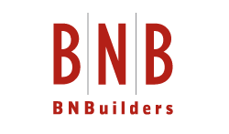












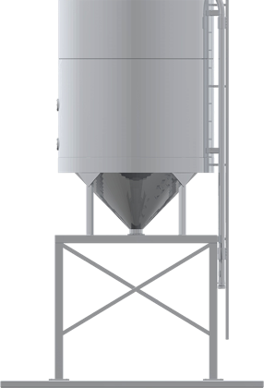
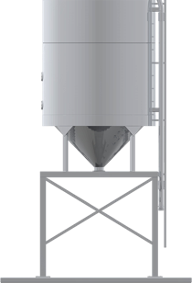

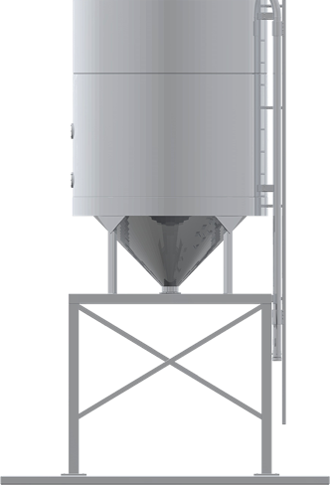
Many Companies Are Producing AR Products and Services, but . . .
Proprietary
Technology Silos

Slide 5
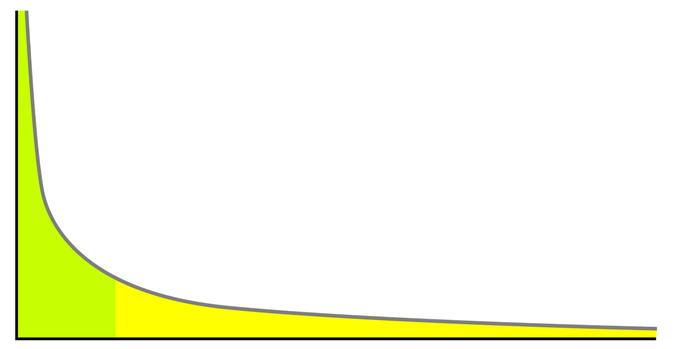
Augmented Reality Developers and their Experiences
Top <10% are responsible for > 50%
Next 10% are responsible for 20%
80% of developers have only a
few AR experiences

Slide 6

Mobile AR-Enabled vs. Users
1B Smartphones with all necessary sensors and graphics acceleration hardware
Only <10% are users of mobile AR
6
Notes:
Gartner statistic for the Smartphones
50M AR Browsers is from the three publishers of these products + 30M Aurasma users + Blippar + AR applications

Slide 7

Enterprise
Augmented Reality

Slide 8
Enterprise Information
2015
Future
2015
Information about enterprise’s physical world is abundant but disconnected from assets and objects
Information at just the right level
and expert support available anywhere, anytime, in context
Lack of accurate information reduces efficiency, inspection and validation are expensive and slow
Performance of critical tasks is
faster, fewer errors and/or risks with higher quality and compliance
Automation reduces need for human labor in many but not all processes
Human skills and strengths serve
to provide value where machines
are inappropriate and/or costly
Notes:
It’s not possible to speak about AR without first reviewing how far we have come from the 1980s when information was beginning to move into digital formats in a big way, and today. We can set the current status in context with the direction in which we are going. It’s not possible to say when we will achieve the state that is described in this slide, but what’s clear to many is that the progress continues in this direction. Driven by many factors and needs to improve efficiency, enterprises continually introduce new technologies to automate processes, letting computers perform increasingly complex tasks in the place of people, but people are still and will remain important in tasks that are rare and require decisions to be made.

Slide 9
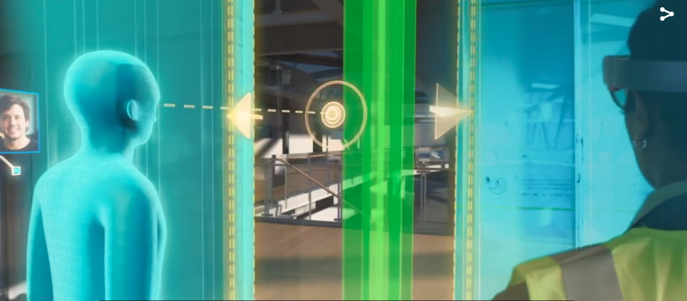
Potential of
Enterprise AR is ENORMOUS
Source: video produced by Microsoft and Trimble showing how a design error can be detected with assistance of Augmented Reality
http://compass.surface.com/assets/04/9a/049aa090-c397-459a-be27-9870c242bc8d.mp4?n=Hololens_Trimble_Optimized.mp4
Notes:
The potential for Augmented Reality is enormous because it will involve some many different use cases and many companies have data that can be used in context. In this slide we evoke a video recently released by Microsoft and Trimble describing the enormous potential for AR to reduce errors and help those on a construction project make decisions. This video shows that a post may go into a door way but since the person who is local and the remote user can see the digital data in context, the plans can be changed in advance. Microsoft is one of the companies that sees the potential for AR to improve the performance of its customers.

Slide 10
Augmented Reality Improves Workplace Performance
Most Relevant Data
Reduce Time
Present only the freshest and contextual information
Particularly for rare and
complex tasks
Boost
Operational
Efficiency
Use Resources Better
Reduce Errors
Keep experts at the disposal of more distributed workforce
Prevent human errors or miscalculations
Real-time Compliance
Reduce Cost
Capture, record and certify achievement of policy compliance
Introduce
Augmented Reality for
real time visualization
Lower impacts of task
interruption and errors
Sensors + Deep Learning + Internet of (Every)thing
Enterprise Information Systems
Notes:
People have heard about Augmented Reality for years, particularly its promises to make consumers more responsive and engage more frequently with big brands. There have also been a number of recent studies about the use of AR in enterprise and industrial environments.
Though that don’t agree on the industries or the timing, analysts who have studied this topic, and the enterprises who have tested it internally, agree that there is great potential for using AR-assisted systems for information delivery in context. The studies emphasize that the benefits are most noticeable when the tasks are unusual or “rare” and complex, and require decision making. In other words, those who perform repetitive and simple tasks don’t need AR. In the future simple and repetitive tasks are going to be increasingly performed by robots and the remaining tasks will be performed by people.
Regardless of the industry, we are in a position to say with strong data to support (from Boeing and NNS) that AR reduces interruptions of complex tasks, and supports decision making in context. Together these can impact/improve the effectiveness of any professional and when collaboration and “look over my shoulder” type of systems are available, the remote worker, for example, the person in a service scenario such as that depicted in the SAP vision video in fall 2014, are able to perform tasks that would otherwise take far longer or more specialized people.
Reduction of errors, as a result of having the correct information in sight on the job during the task, is an easily measured performance metric that has also been demonstrated with AR-assisted systems.
When people make fewer errors, their risk is lower and their use of enterprise resources is higher.
Finally, one of the areas in which AR will likely have a very significant impact is the tracking of tasks in order to maintain technical documentation up to date and to assess quality of work and compliance with corporate policies.
So, together these are many of the cross-industry benefits that AR can provide to enterprise and industrial users, regardless of the use cases.

Slide 11
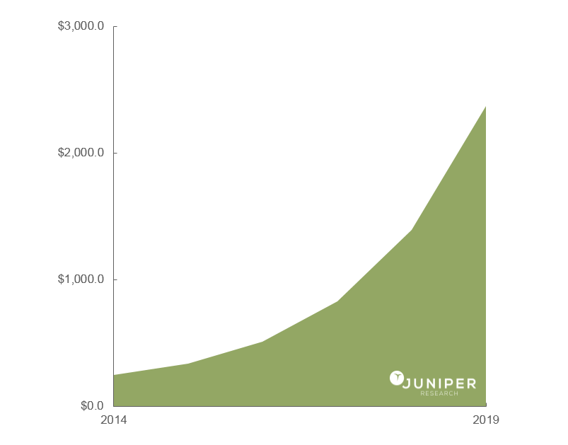
Enterprise Spending on Augmented Reality
$2.4B
Global enterprise spending
$240M
Source: Juniper Research Augmented Reality: Consumer, Enterprise & Vehicles 2015-2019 (April 2015)
Editorial Note: This forecast is only for software licenses, subscriptions, and app-store spending.
Custom engineering, development, integration and hardware costs are not included.

Slide 12

But There Are Barriers
STREET
CLOSED
DO NOT

Slide 13

Just to Mention a Few…
Customers ask . . .
  What are current tools’ strengths and pitfalls?
  Where is vendor-neutral information describing
  available options?
  What are best practices learned from live deployments?
Providers need . . .
  Deeper understanding
  of real customer needs
  Partnerships with
  others in AR ecosystem
Both customers and providers need…
  Reduce tendency to “re-invent the wheel” on
  technical obstacles (both easy/obvious and difficult)
  Clarity on business considerations (benefits, pricing)
Notes:
We are bullish and confident that AR will improve performance, once it is introduced and adopted. It can already be tested and prove quite effective in some settings that are well defined and conditions controlled.
This said, the introduction of AR is still hampered by a number of factors in addition to those that are frequently raised with any new technology such as cost and lack of policies for use (security, privacy, etc). The customers are not sure what they are looking for or what they need. There is a lower than optimal awareness of current tools, their strengths and pitfalls, and a total absence of vendor-neutral information about the options available.
There are live deployments but those involved are not eager to share them because they want to benefit from the strategic advantage or to charge new customers for their existing/dearly earned knowledge and know how. This last obstacle is understandable, but addressable.
The providers of enterprise AR must invest heavily, sometimes with sales cycles exceeding a year, in order to train their future customers. The providers would have greater revenues if there were more qualified (pre-qualified) customers and if they were partnering with companies to deliver “full solutions” instead of partial implementations that are not integrated in the enterprise IT system.
Both the customers and the providers lack the shared knowledge to quickly troubleshoot issues so there is a high tendency to “re-invent the wheel” on common obstacles, things that could be shared widely to address the most obvious issues rather than selling the customer a more complicated solution.
Finally, customers don’t know what they should be paying for or how much. The providers do not have any guidance on the features that they promote or sell so there’s low or no ability to compare solutions. While there can’t be fixed pricing, transparency and a fee for value model benefits both the providers and customers

Slide 14
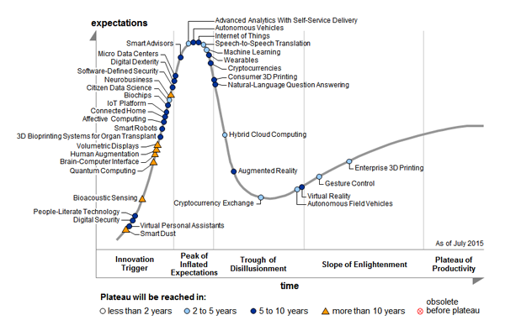
Trough of Disillusionment

Slide 15
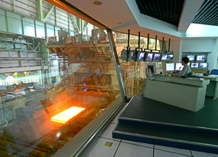




Our Vision
One global, member-based organization accelerating AR adoption in the enterprise
Expansion of a vibrant, new technology ecosystem
Solutions
Components, Systems and Services
Non-commercial entities
Customers
Fortune 500 and Global 2000 in asset-intensive industries
Needs
Providers
Notes:
The AREA is the only global organization based on member needs and concerns around enterprise AR. We are focused on accelerating AR adoption in enterprise. We will do this by supporting the development of a vibrant new technology ecosystem of providers, integrators and customers.
In this graphic, we illustrate that customers have needs that can be addressed with AR, and with better education/information about the capabilities of AR, not the hype, they will know what they are seeking and the providers are more able to meet the needs of the customers.
IN the middle we highlight the non-commercial entities that “amplify” the speed and effectiveness of our ecosystem by meeting a number of needs: they reach audiences we do not normally communicate with and they will provide trained/skilled workforce and better interoperability with standards.
The providers include:
AR experience developers
Independent software publishers
Software as a Service providers
Semiconductor, incl. MEMS
Handset component providers
Device integrators
Wearable computing vendors
Display technology providers
Network operators
Network equipment providers
Systems integrators
The industries they will (or are already) serving include:
Automotive & Commercial Vehicle
Aviation & Aerospace
Naval Engineering
Healthcare
Architecture & Construction
Engineering
Education
Public Sector & Governments (National, State, Municipal)
Logistics
Manufacturing
Oil & Gas
Industrial Equipment
Metals & Mining
Power & Energy
Utilities

Slide 16















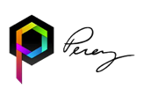



Our Members

Slide 17
Community for Open and Interoperable
Augmented Reality

Slide 18

Open and Interoperable AR
Any
AR Use Cases
AR Experience
Authoring
Tools and Workflows
AR experience on any
form factor and using
any standards-compliant
software client
Millions of developers with access, skills and expressed desire to author AR experiences
Billions of people with at least one AR-ready device (sensors and output/display support)
Any Digital Assets

Slide 19

Open and Interoperable AR
Permits consistent and flexible content and technology integration and management
Interoperability simplifies the developer’s AR experience
  Authoring
  Publishing
  Integration
Interoperability increases user’s
  Discovery
  Sharing
  Consuming

Slide 20

AR Community
Grassroots community of people since 2009
Seek open and interoperable
AR content and experiences
  Brings together standards development organizations and developers
Operate
  A Web portal
  Seven archived mailing lists
Conduct virtual and in-person meetings

Slide 21
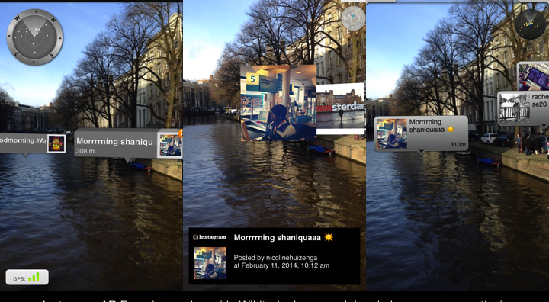
Notable Achievements to Date
Initiatives
  Cross-SDO (OGC, Khronos Group, ISO, Web3D) collaboration
  to address 3D Compression and Transmission
  Development of
  AR Browser
  interoperability
Resources
  Tables of relevant standards and status of active SDOs
  Calendar of meetings and events
  Glossary of AR terminology
  Mixed and Augmented Reality Reference Model (ISO)

Slide 22


















Relevant Industry Groups and
Standards Organizations
National
Standards
Organizations

Slide 23


Most Active Standards Groups
  WebGL
  glTF
  OpenVX
  OpenKCam
  StreamInput
  Mixed and Augmented Reality Reference Model (MAR RM)
  AR Application Format (ARAF)
  ARML 2.0
  IndoorGML
  OWS Context
  GeoPackage
  Moving Features
  Points of Interest
  3D Medical Display
  Streaming Media Quality
  Streaming to Mobile
  xAPI
  Simulation and Virtual Reality
  AR Learning Experience Model

Slide 24
Next Meeting
Oct 6 & 7 2015
Host: SK Telecom
Venue: SK Telecom Tower (Seoul, Korea)
http://www.perey.com/ARStandards/october-2015-ar-community-meeting/

